Slide 1
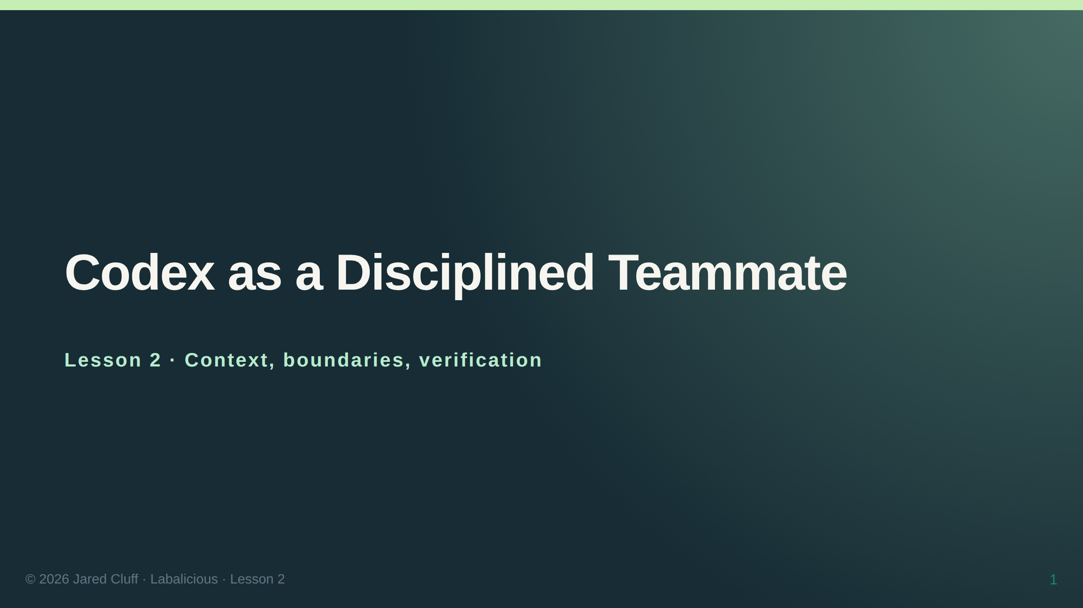

Slide 2
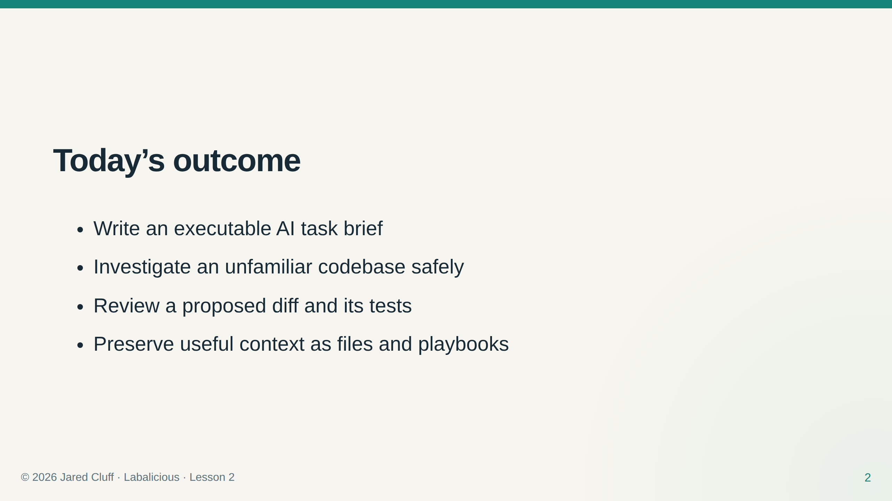

Slide 3
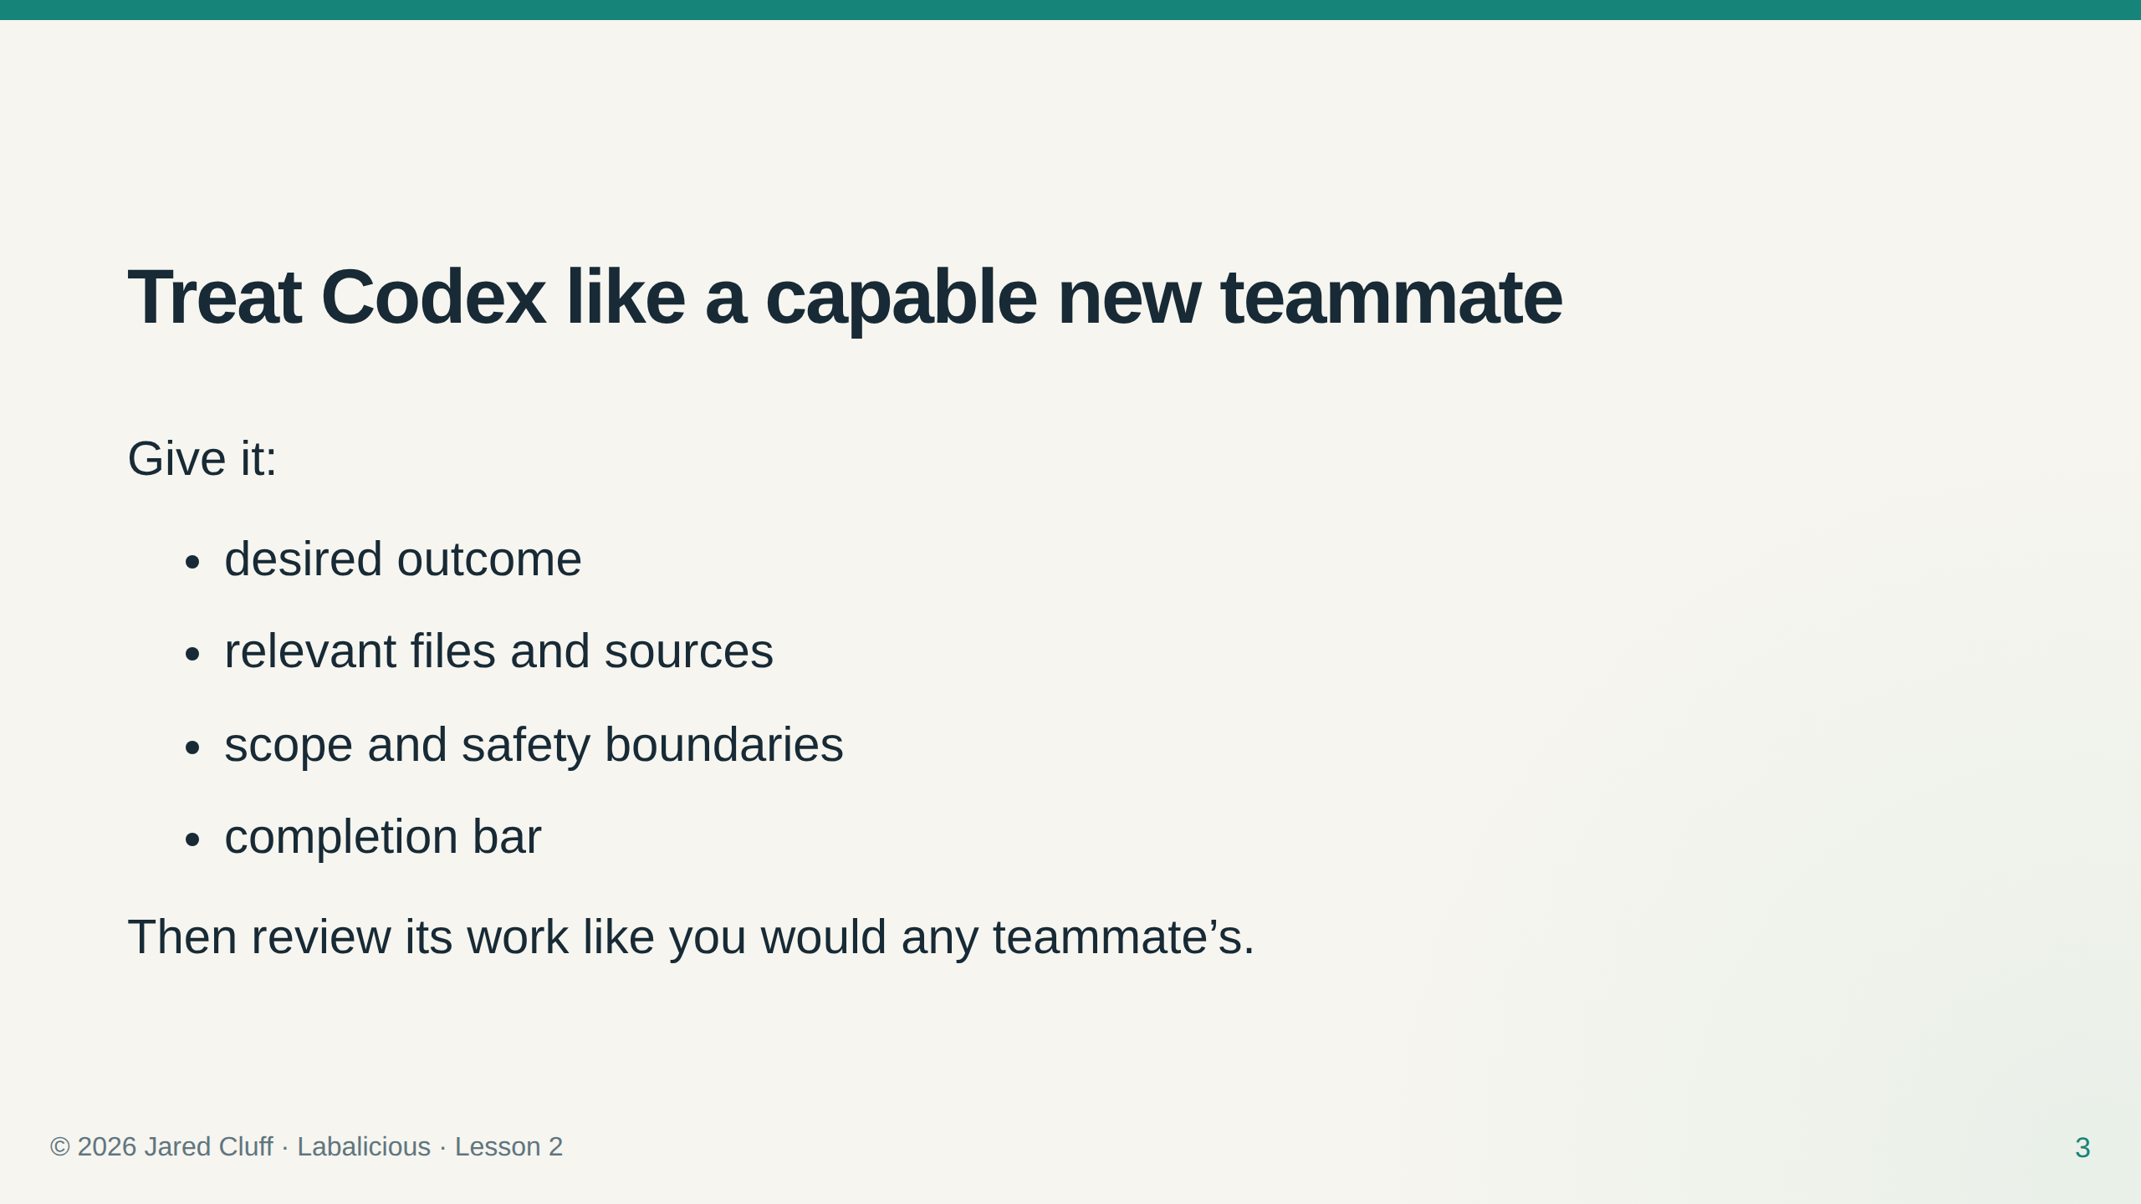

Slide 4
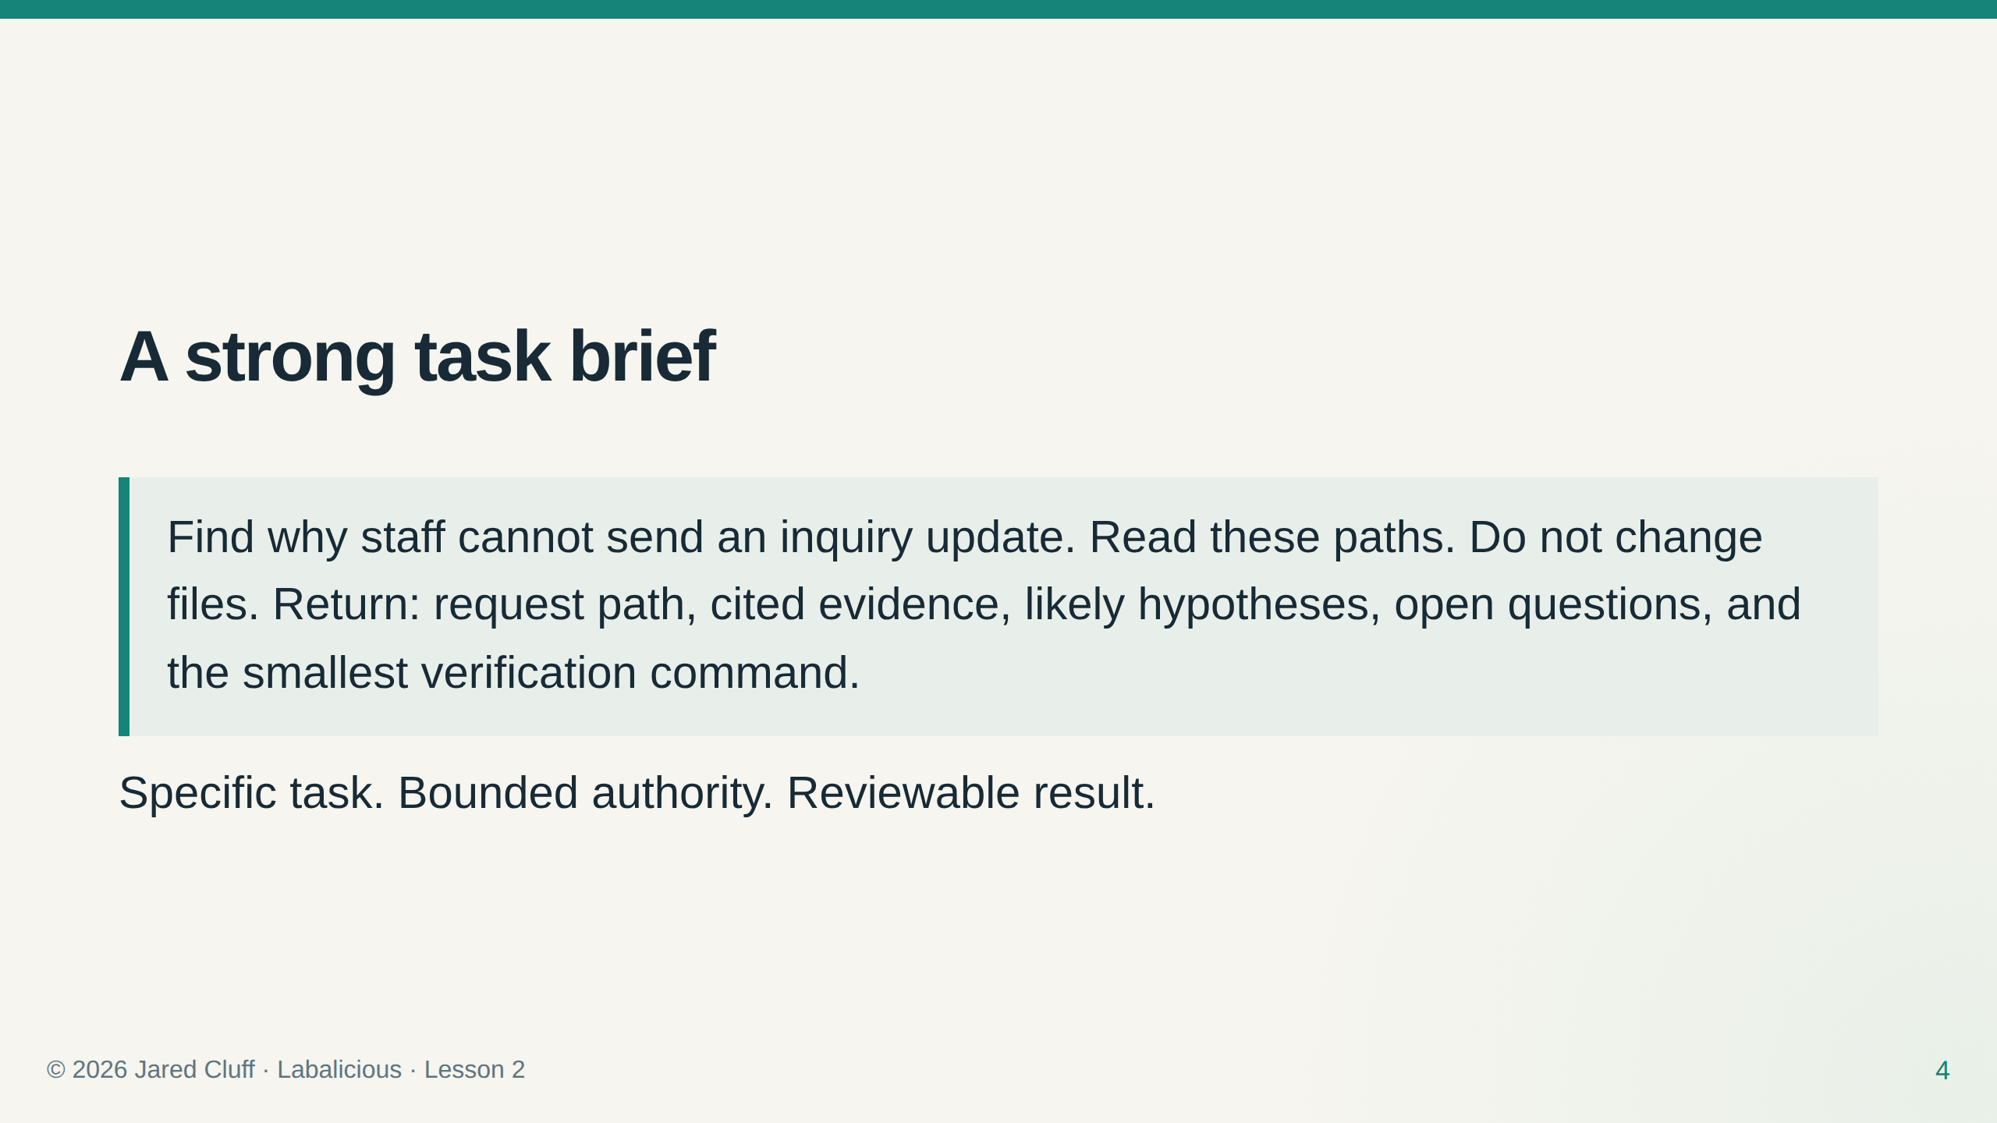

Slide 5
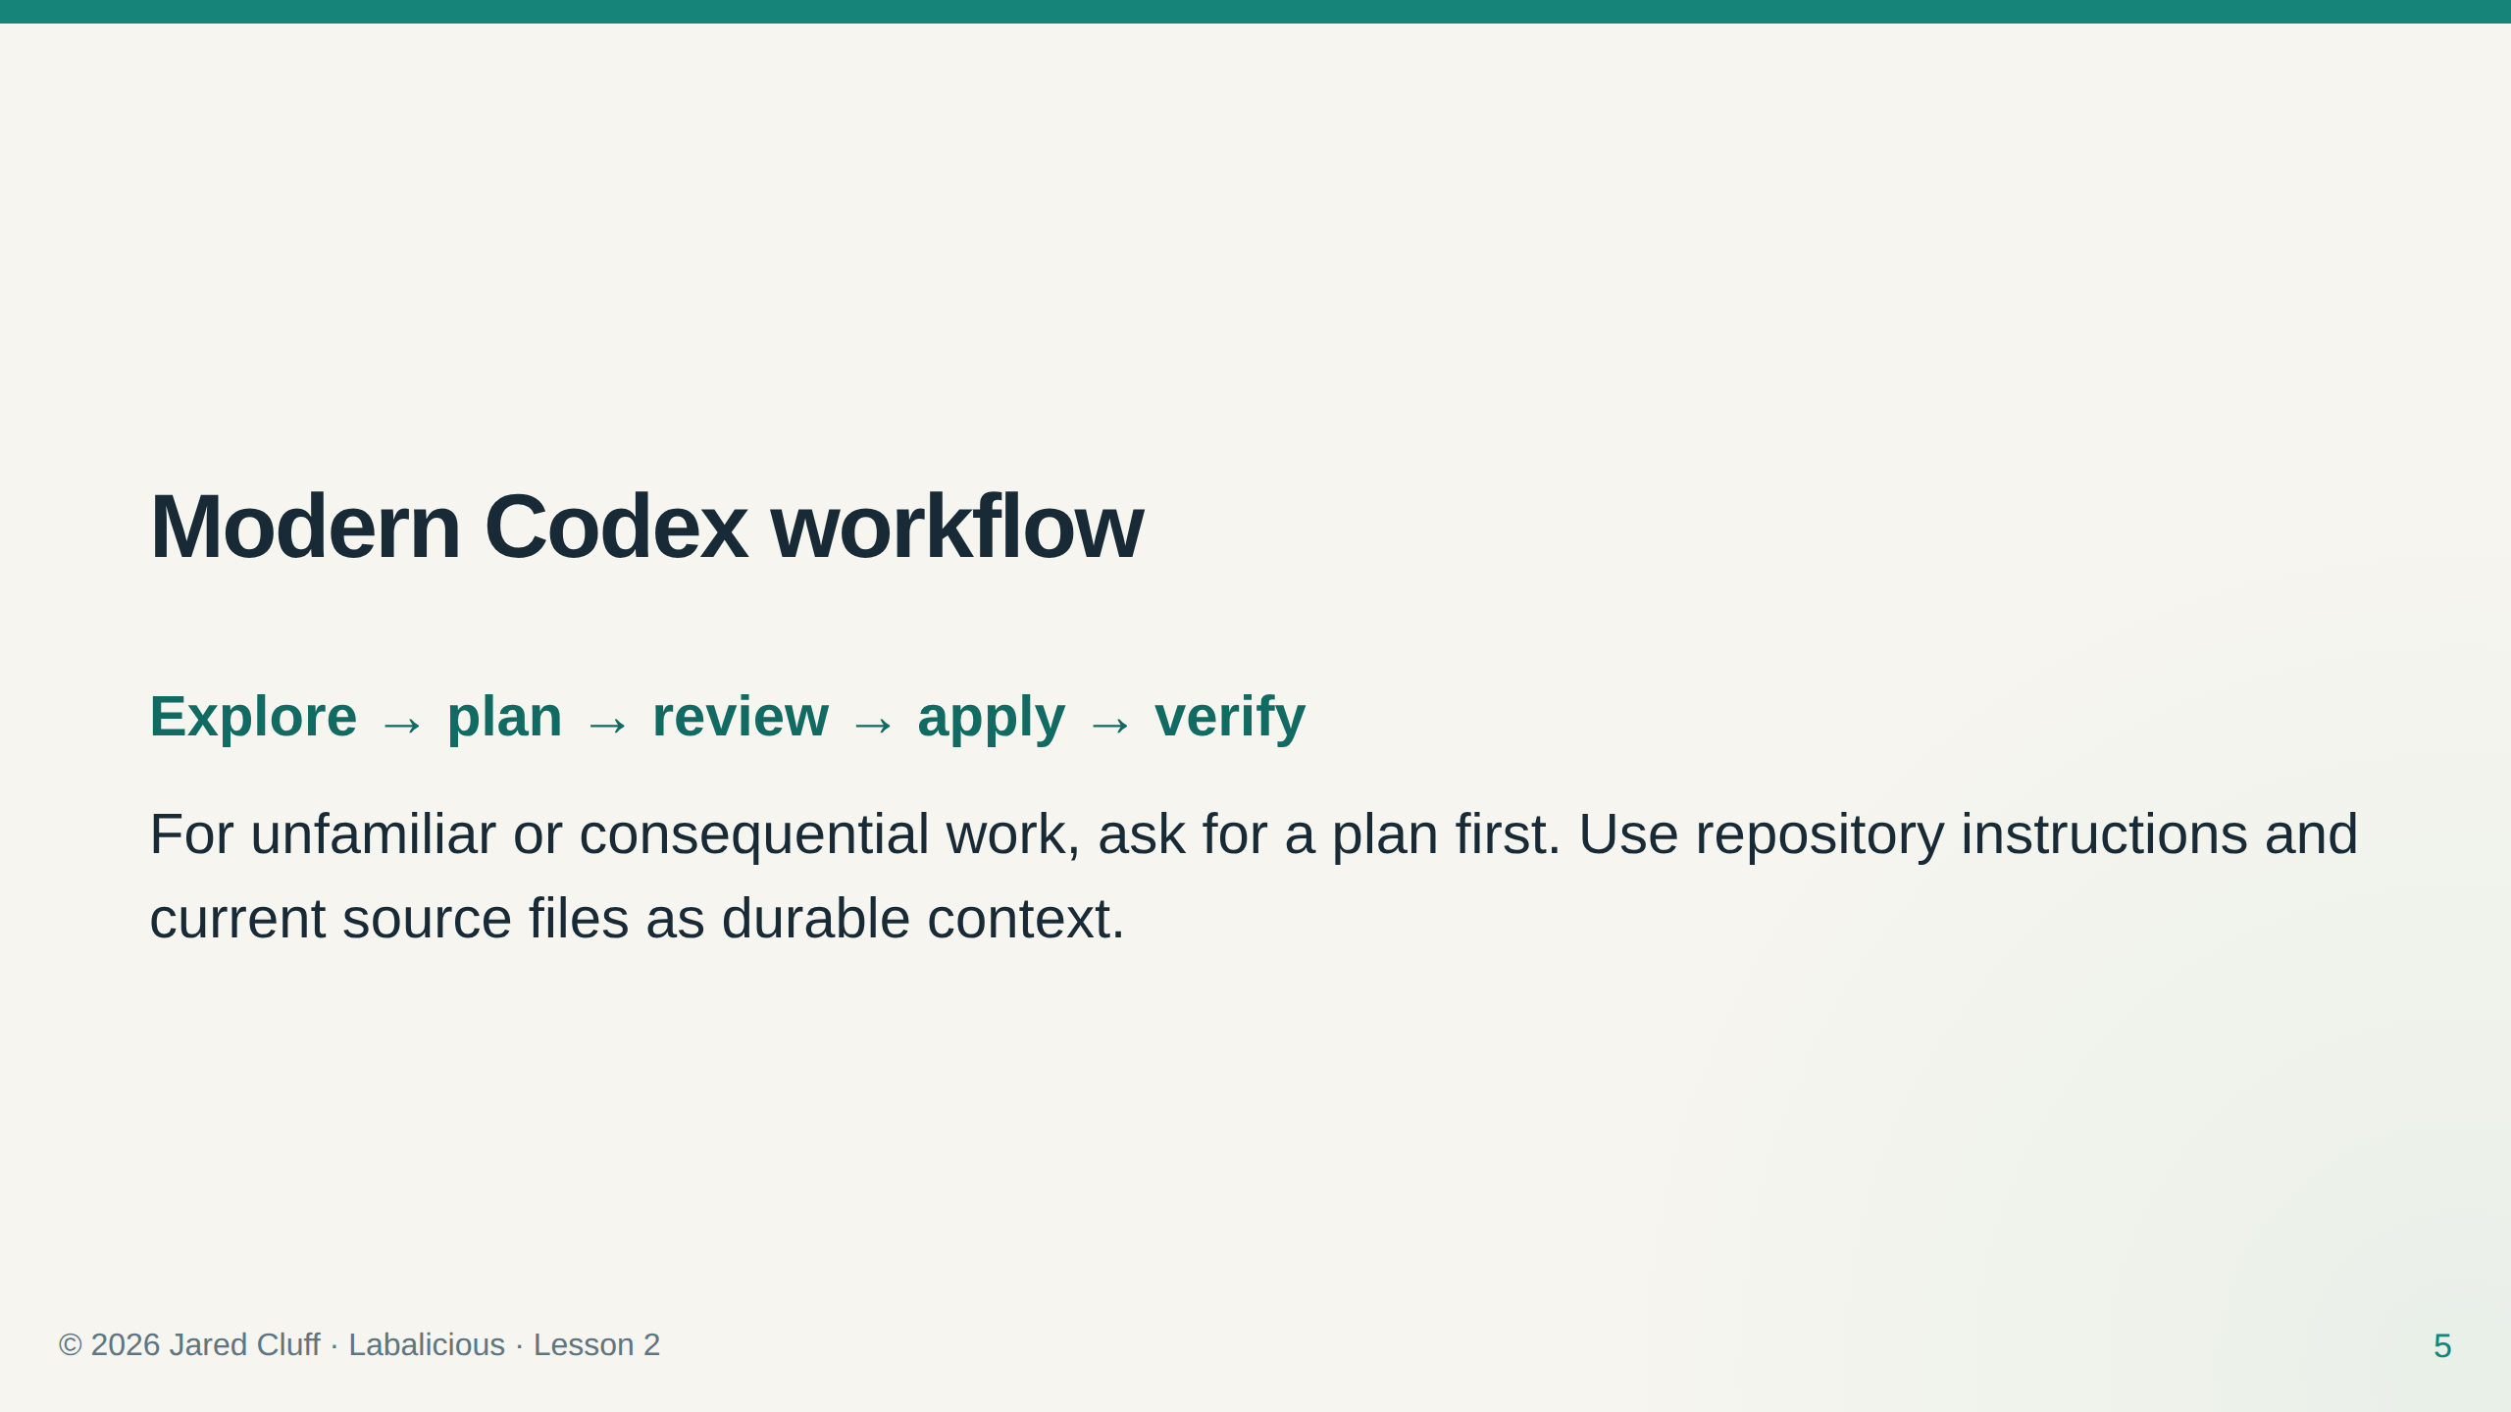

Slide 6
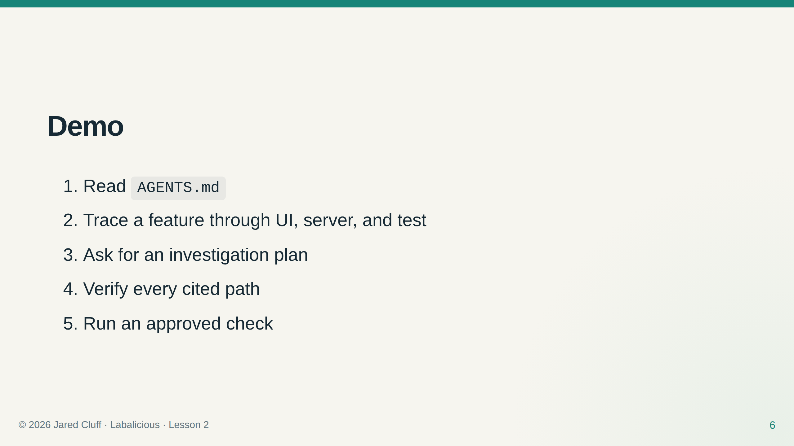

Slide 7
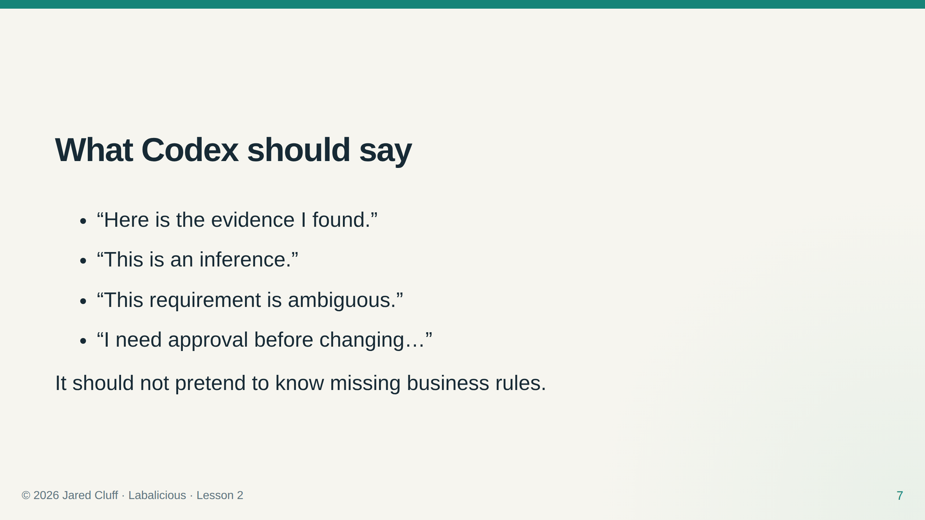

Slide 8
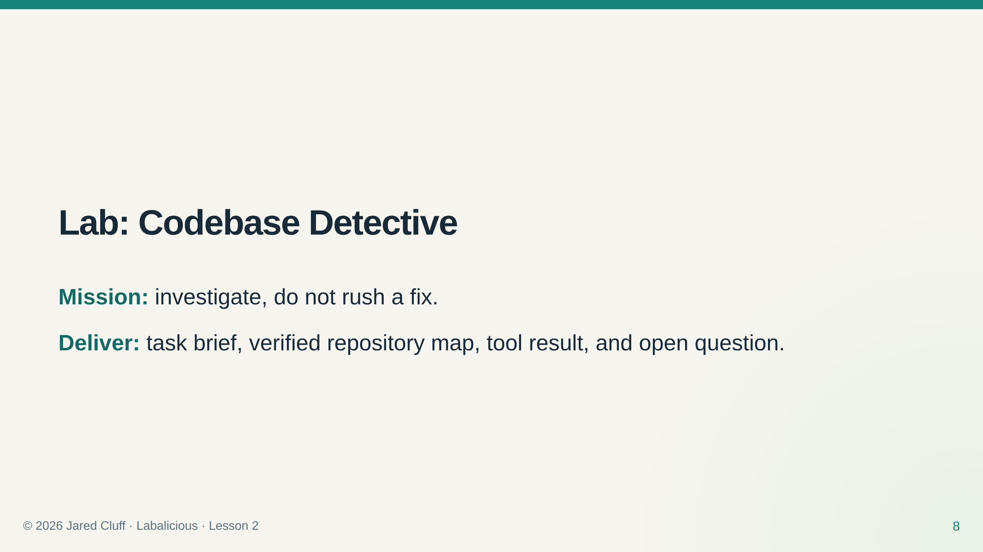

Slide 9
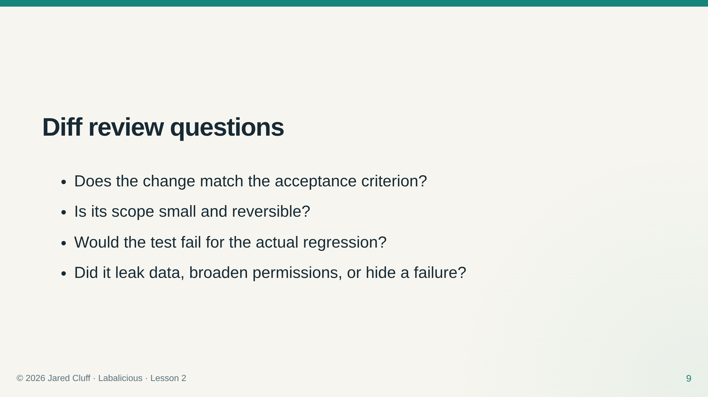

Slide 10
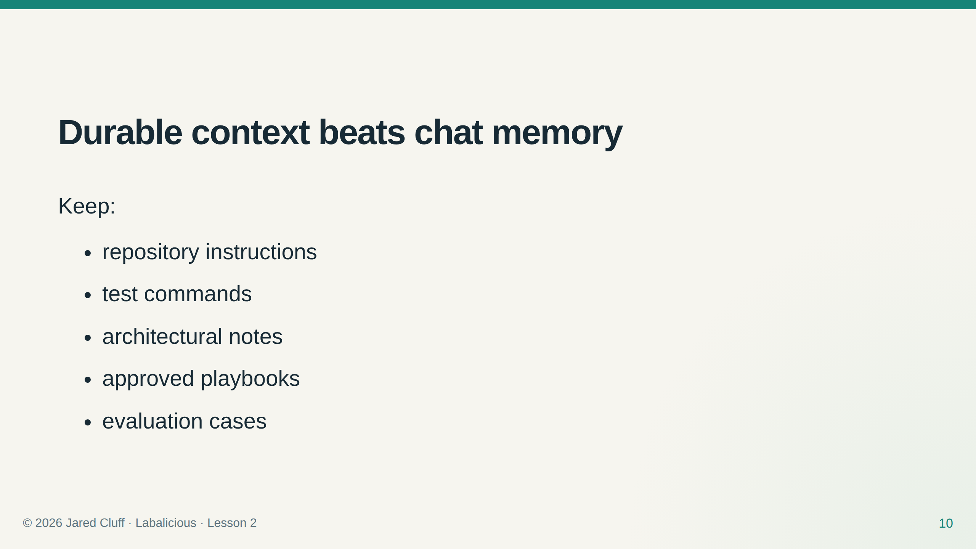

Slide 11
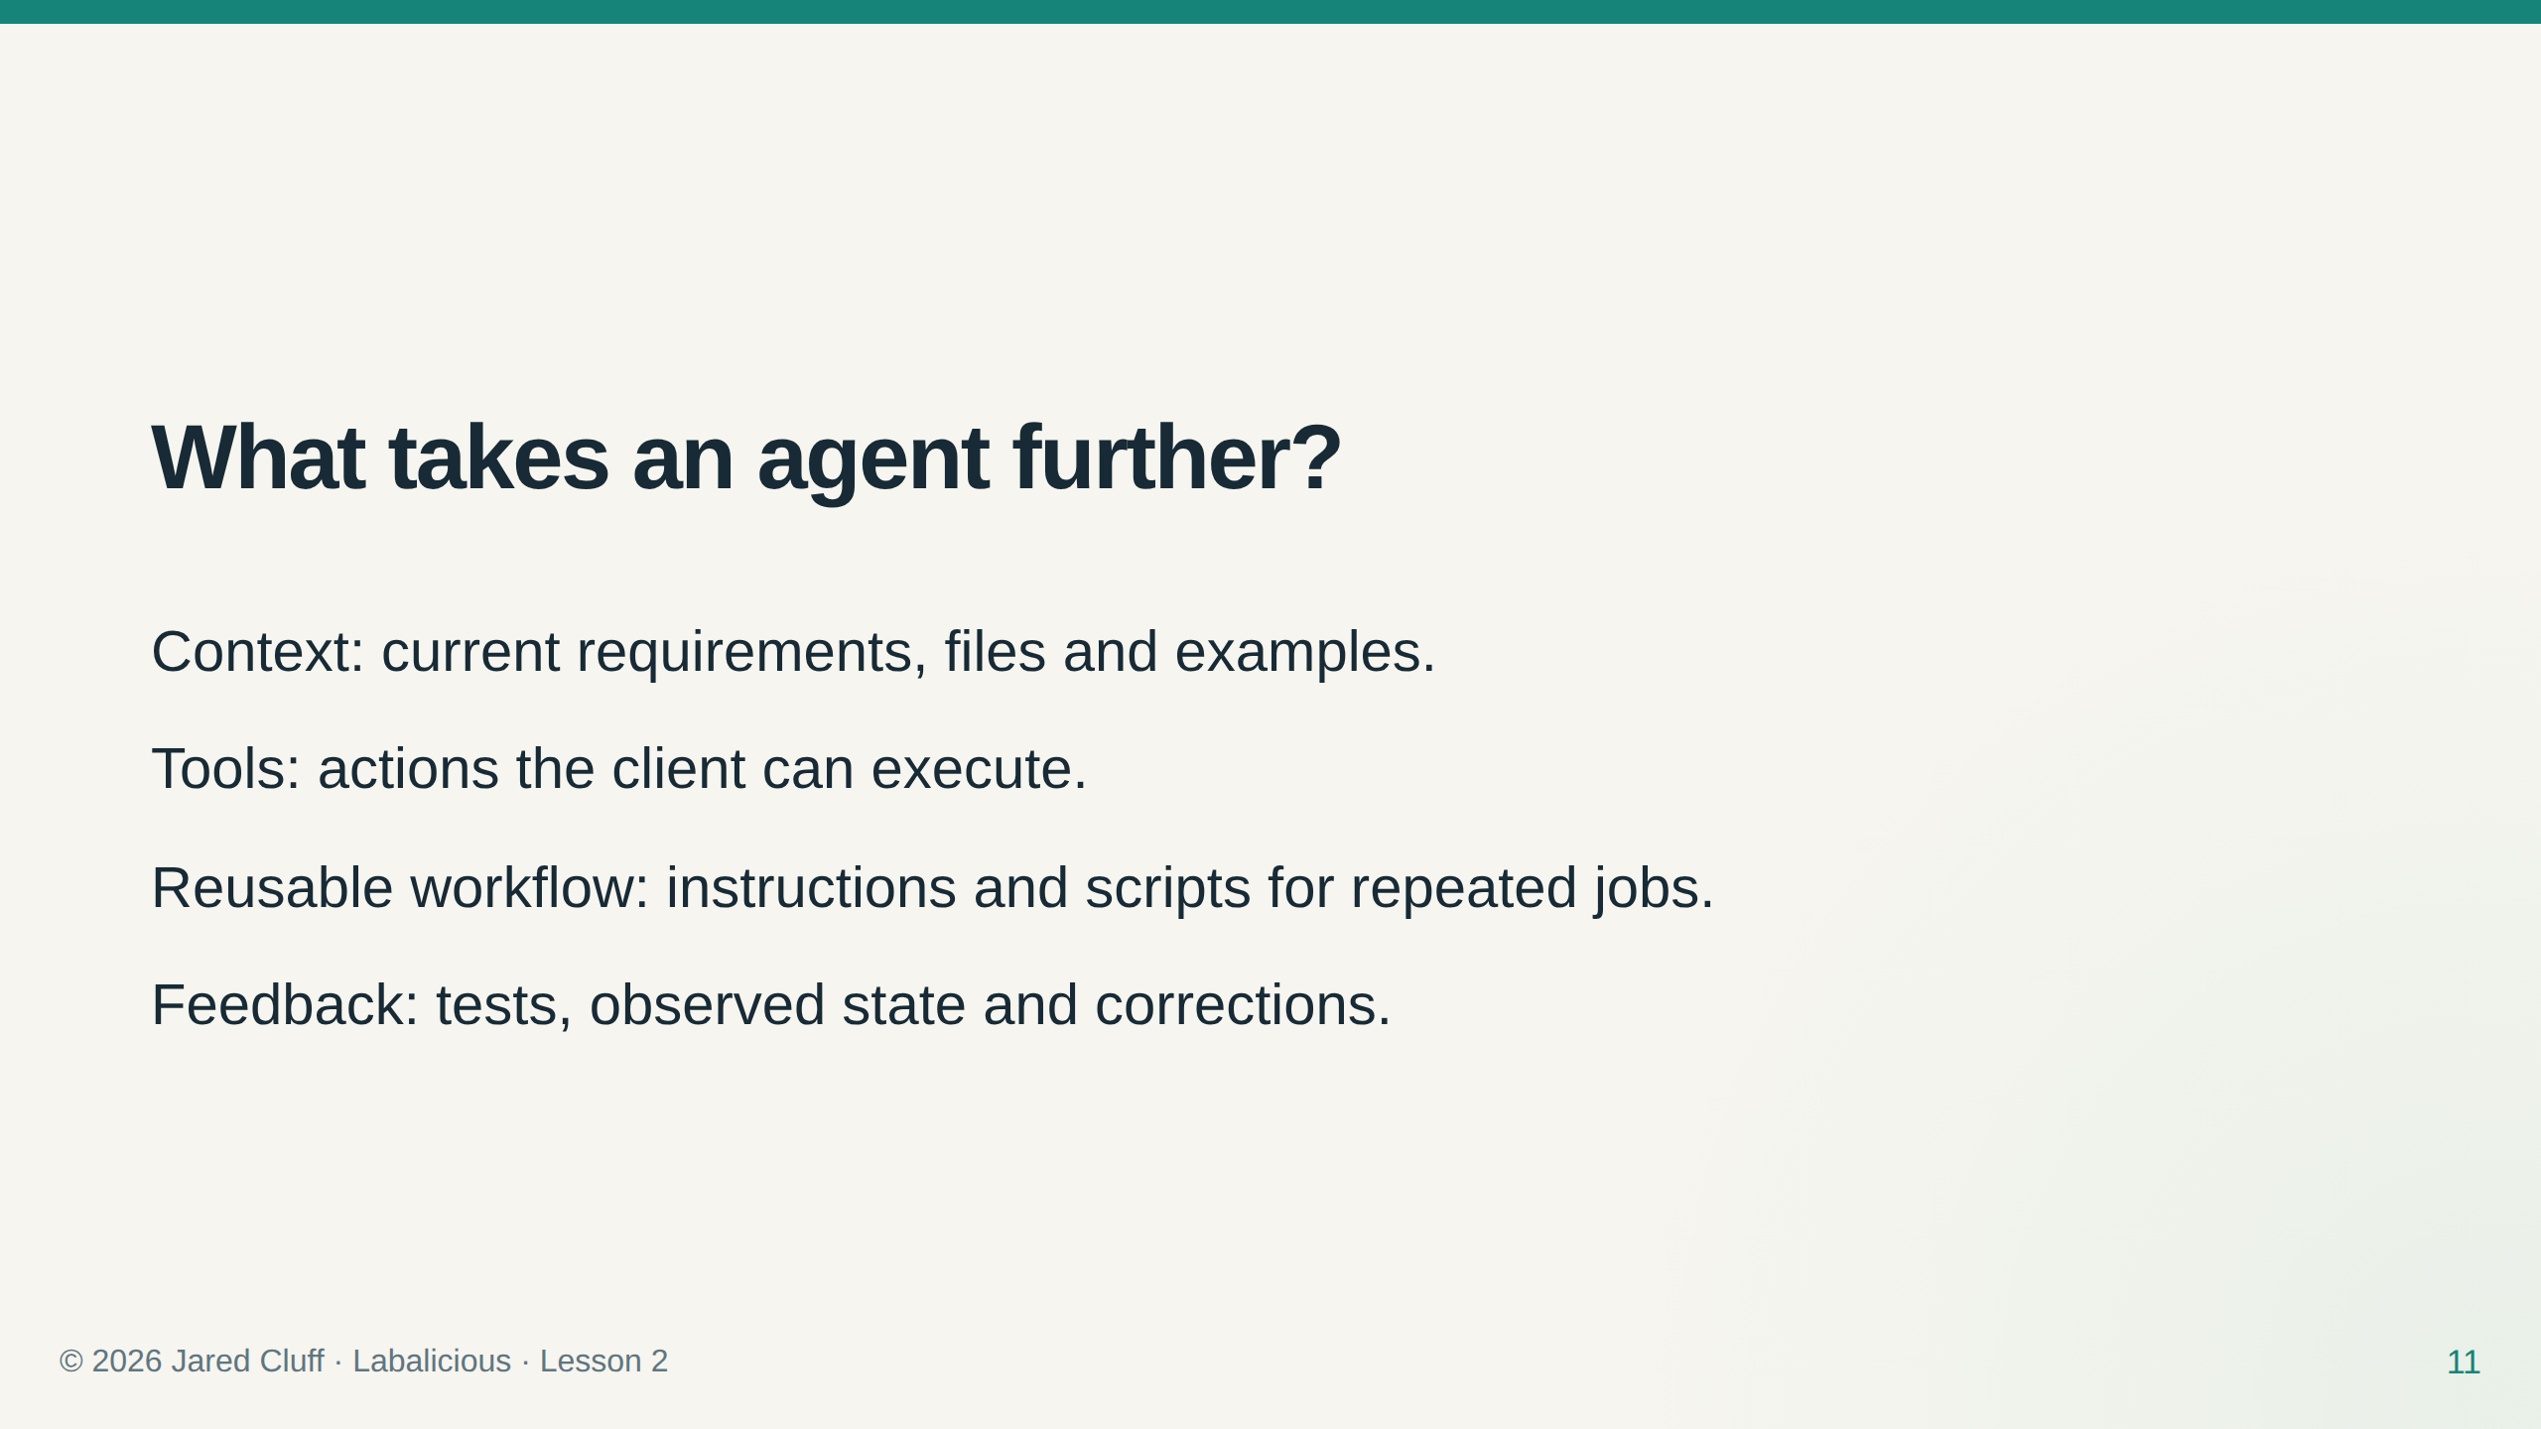
Notes:
Ask which missing element blocks a spreadsheet-to-CRM workflow. A model cannot read a file it has not been given or use an unavailable tool.

Slide 12
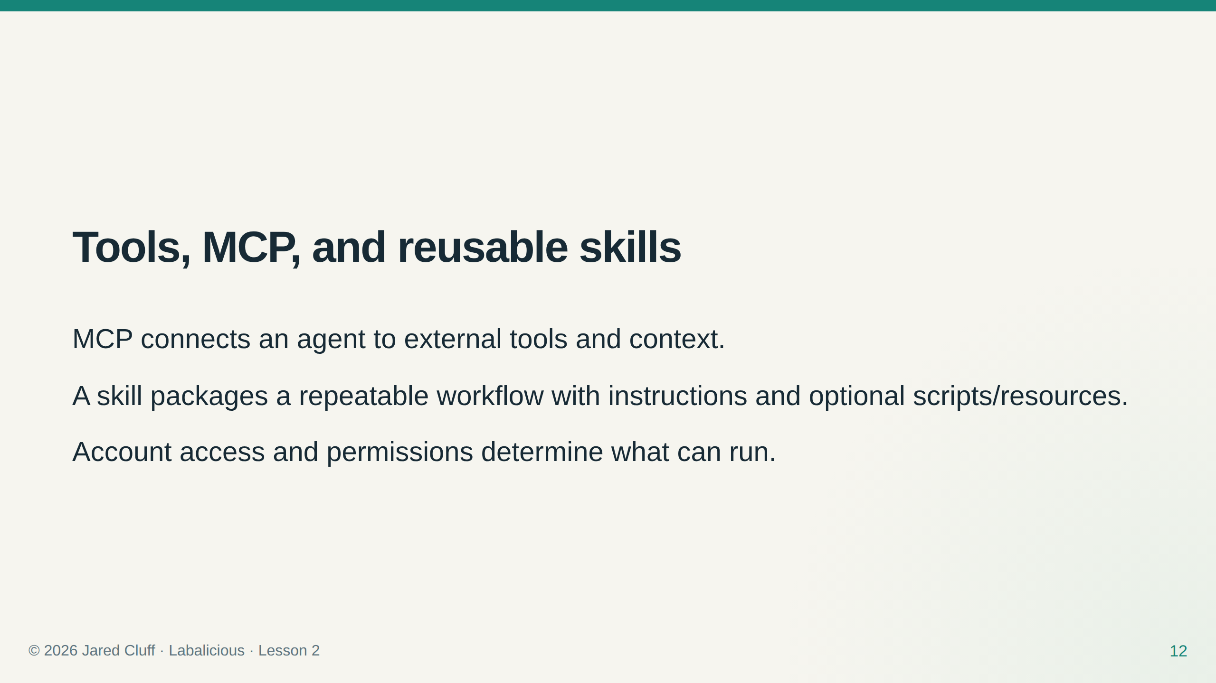
Notes:
Sources: https://learn.chatgpt.com/docs/extend/mcp?surface=cli and https://learn.chatgpt.com/docs/build-skills. Inspect tools available to this cohort; do not promise a native Google/Discord connector.

Slide 13
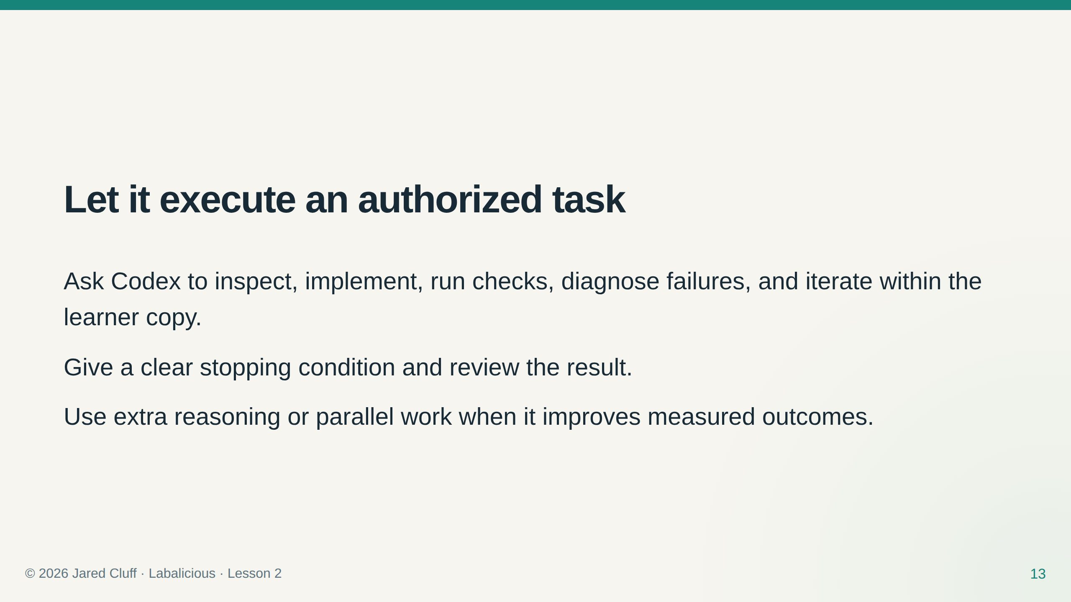
Notes:
Demonstrate a complete local edit/test cycle. Routine authorized local steps do not require repeated approval.

Slide 14
