Slide 1
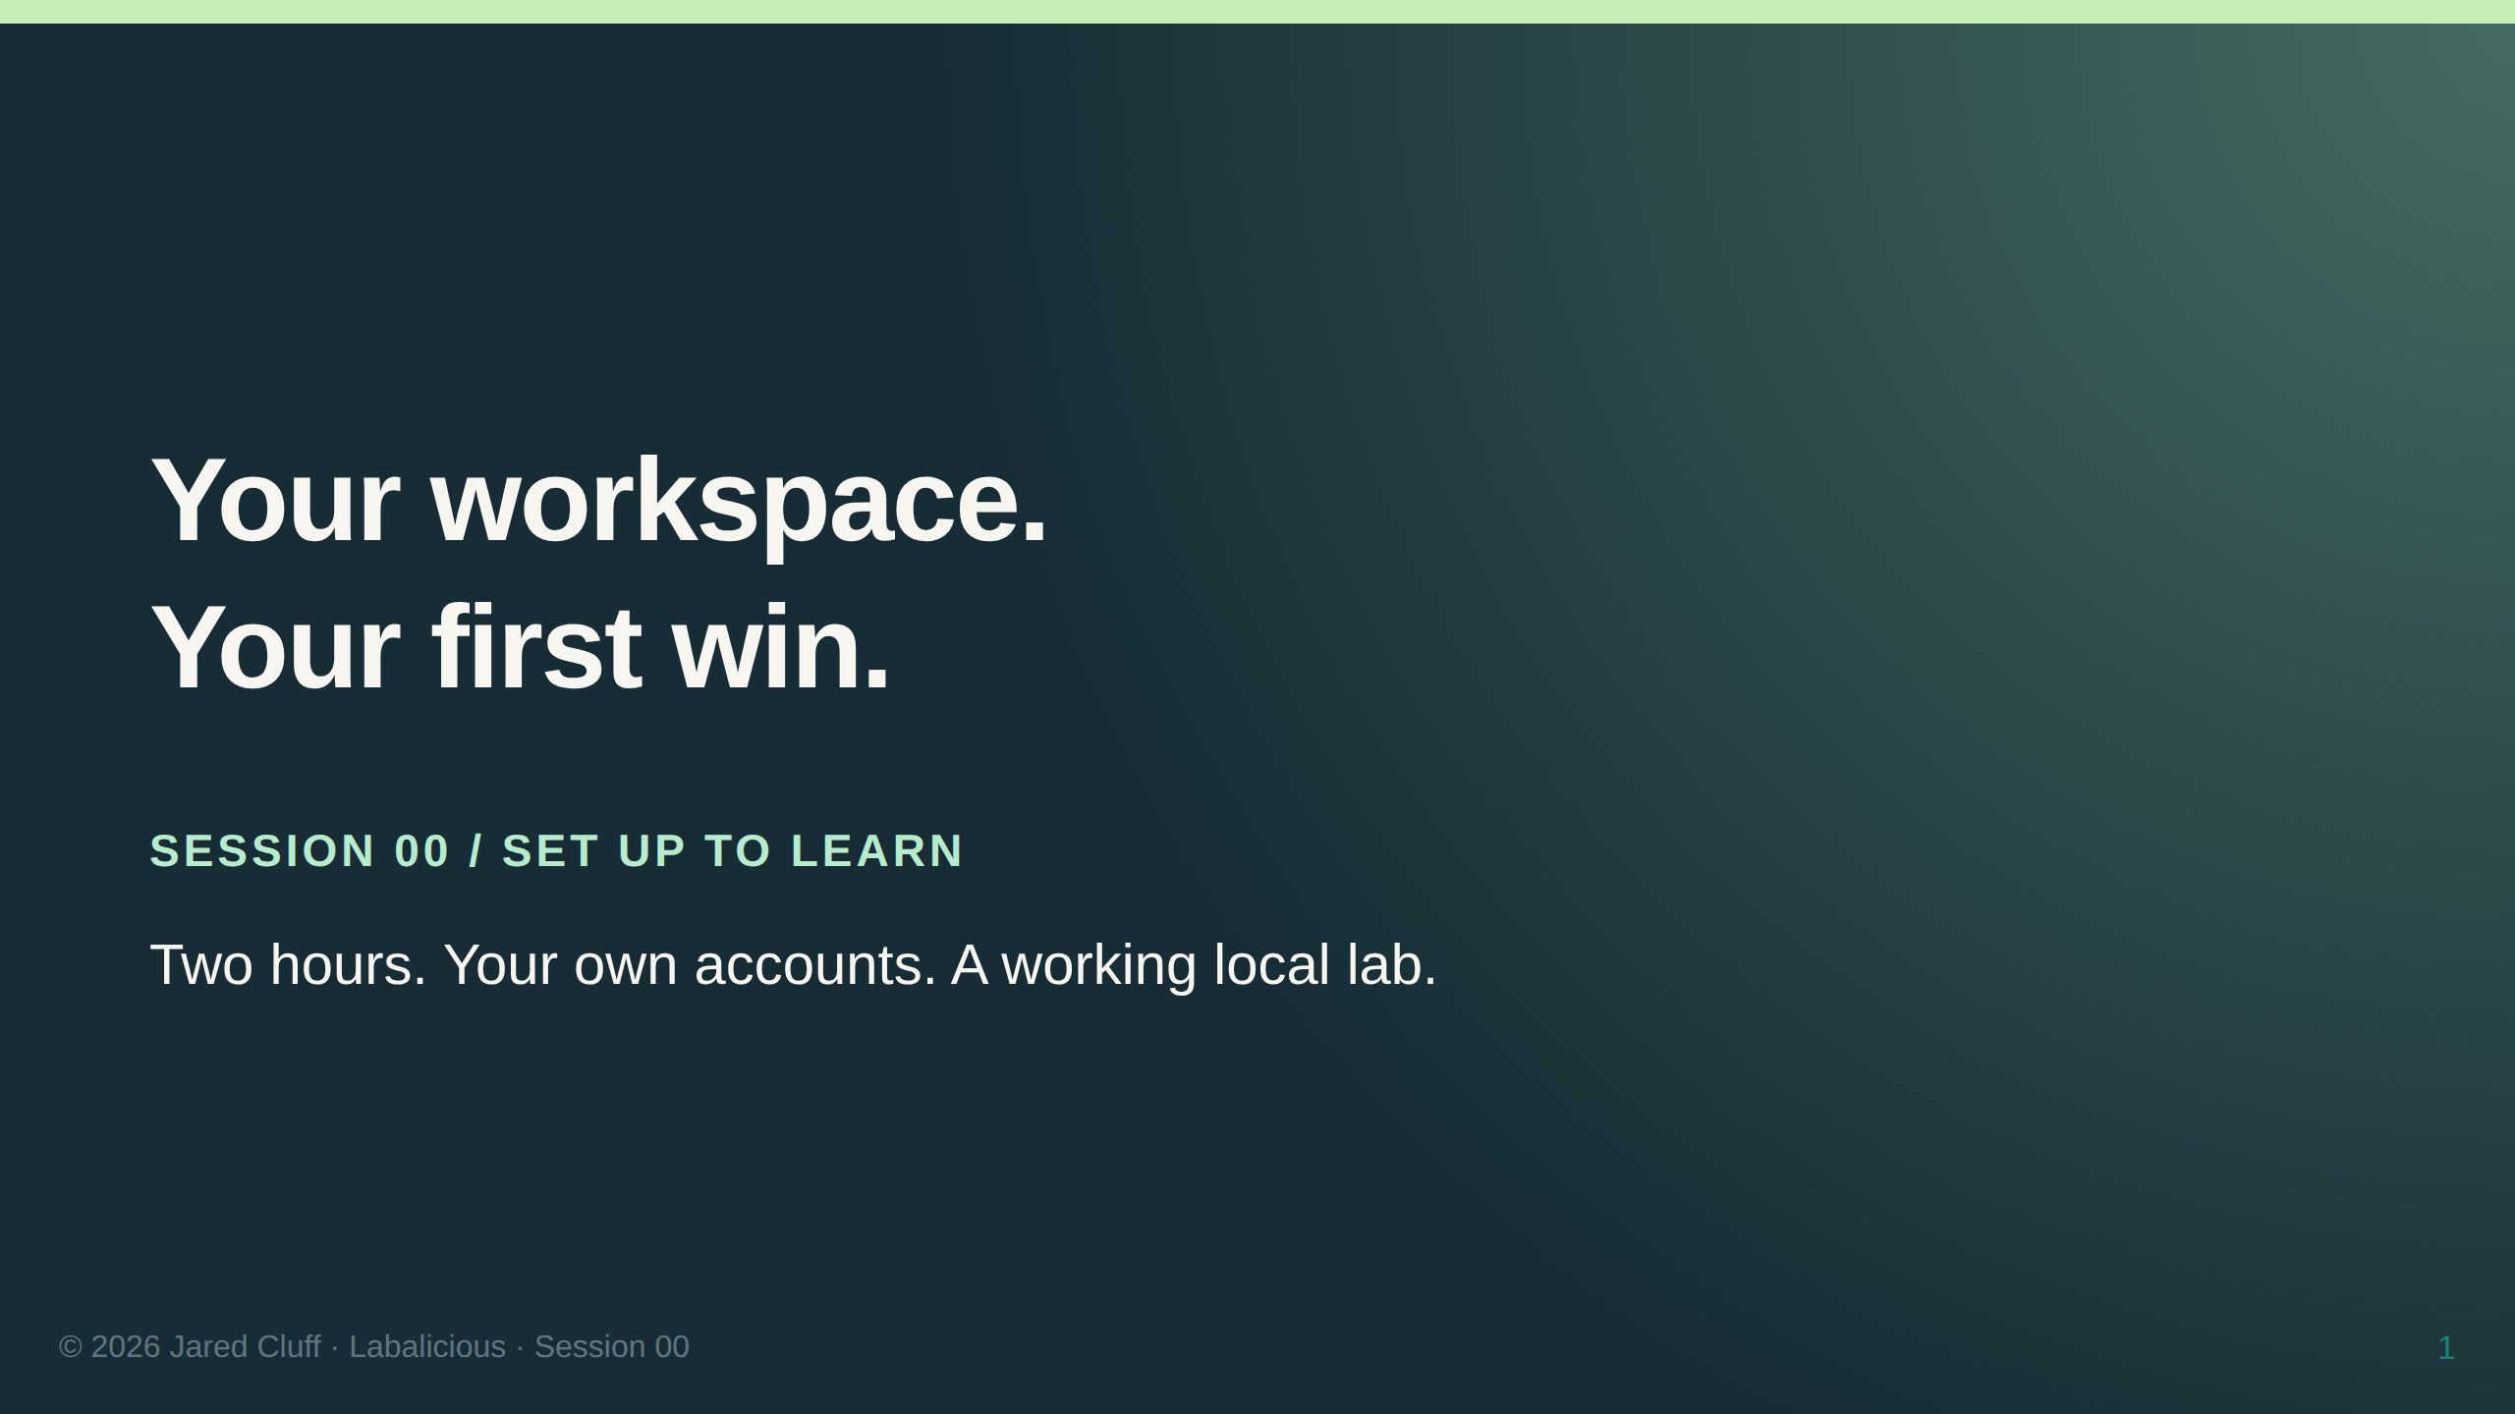

Slide 2
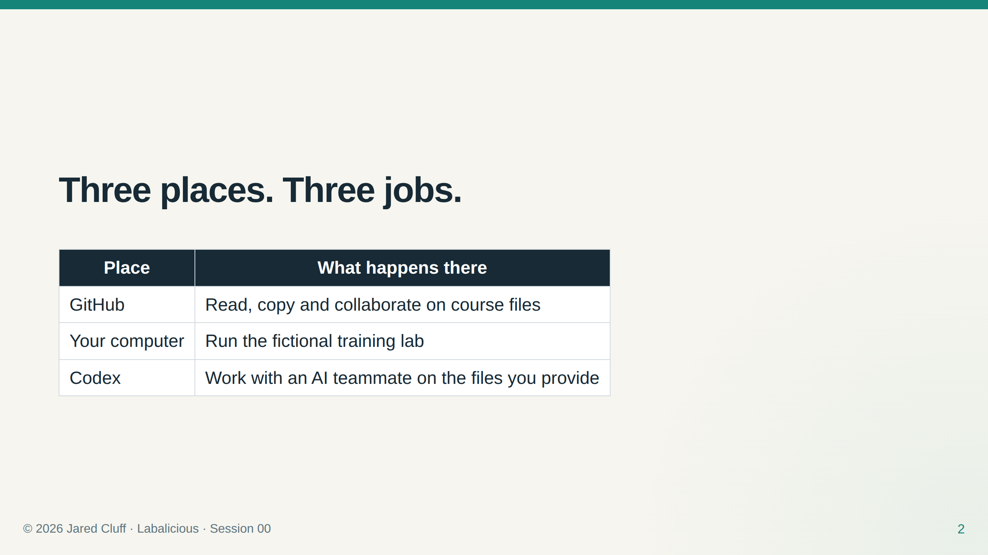
Notes:
Show each place separately. Ask learners which service owns which action.

Slide 3
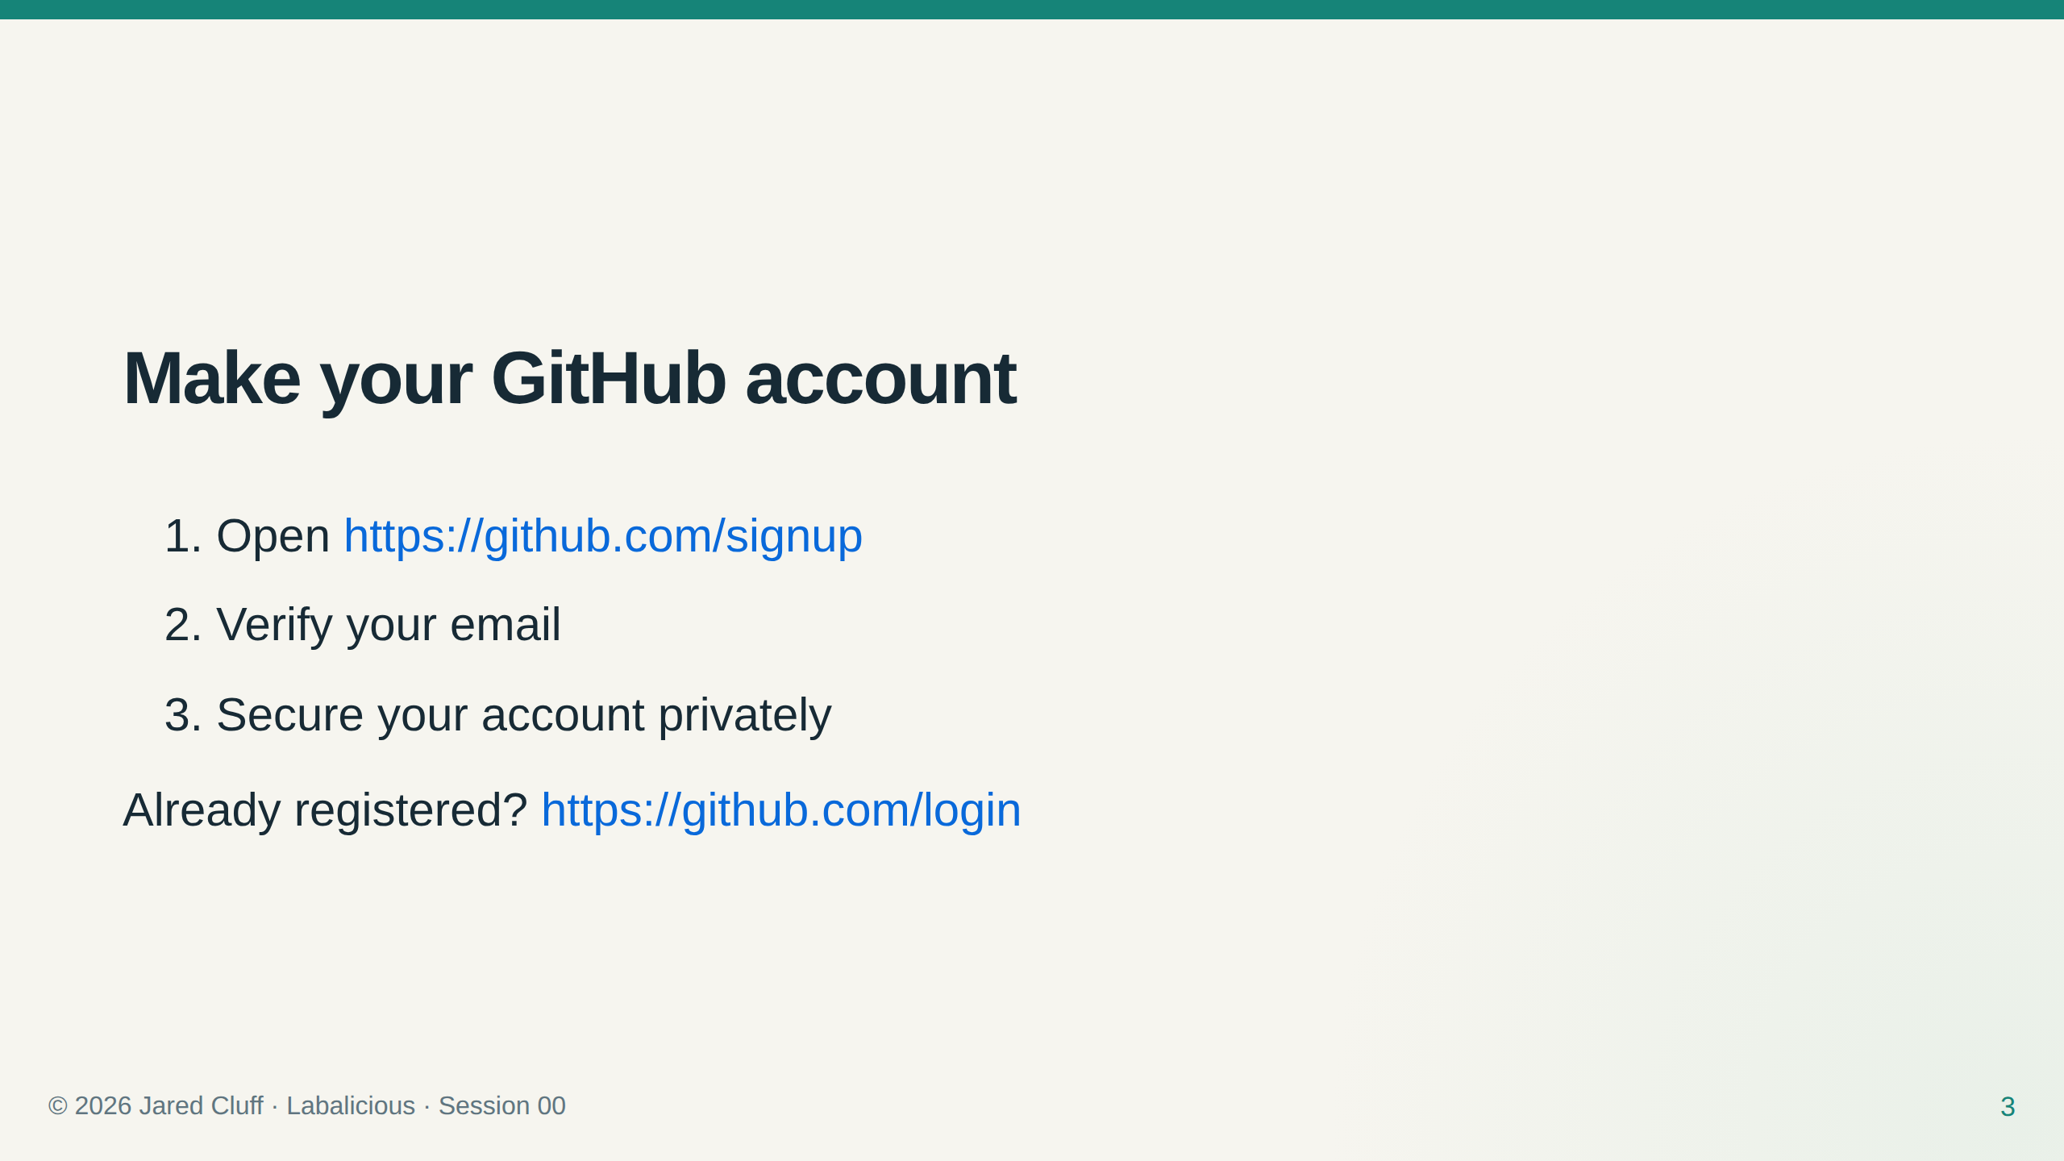
Notes:
10–25 minutes. Never collect passwords or recovery codes.

Slide 4
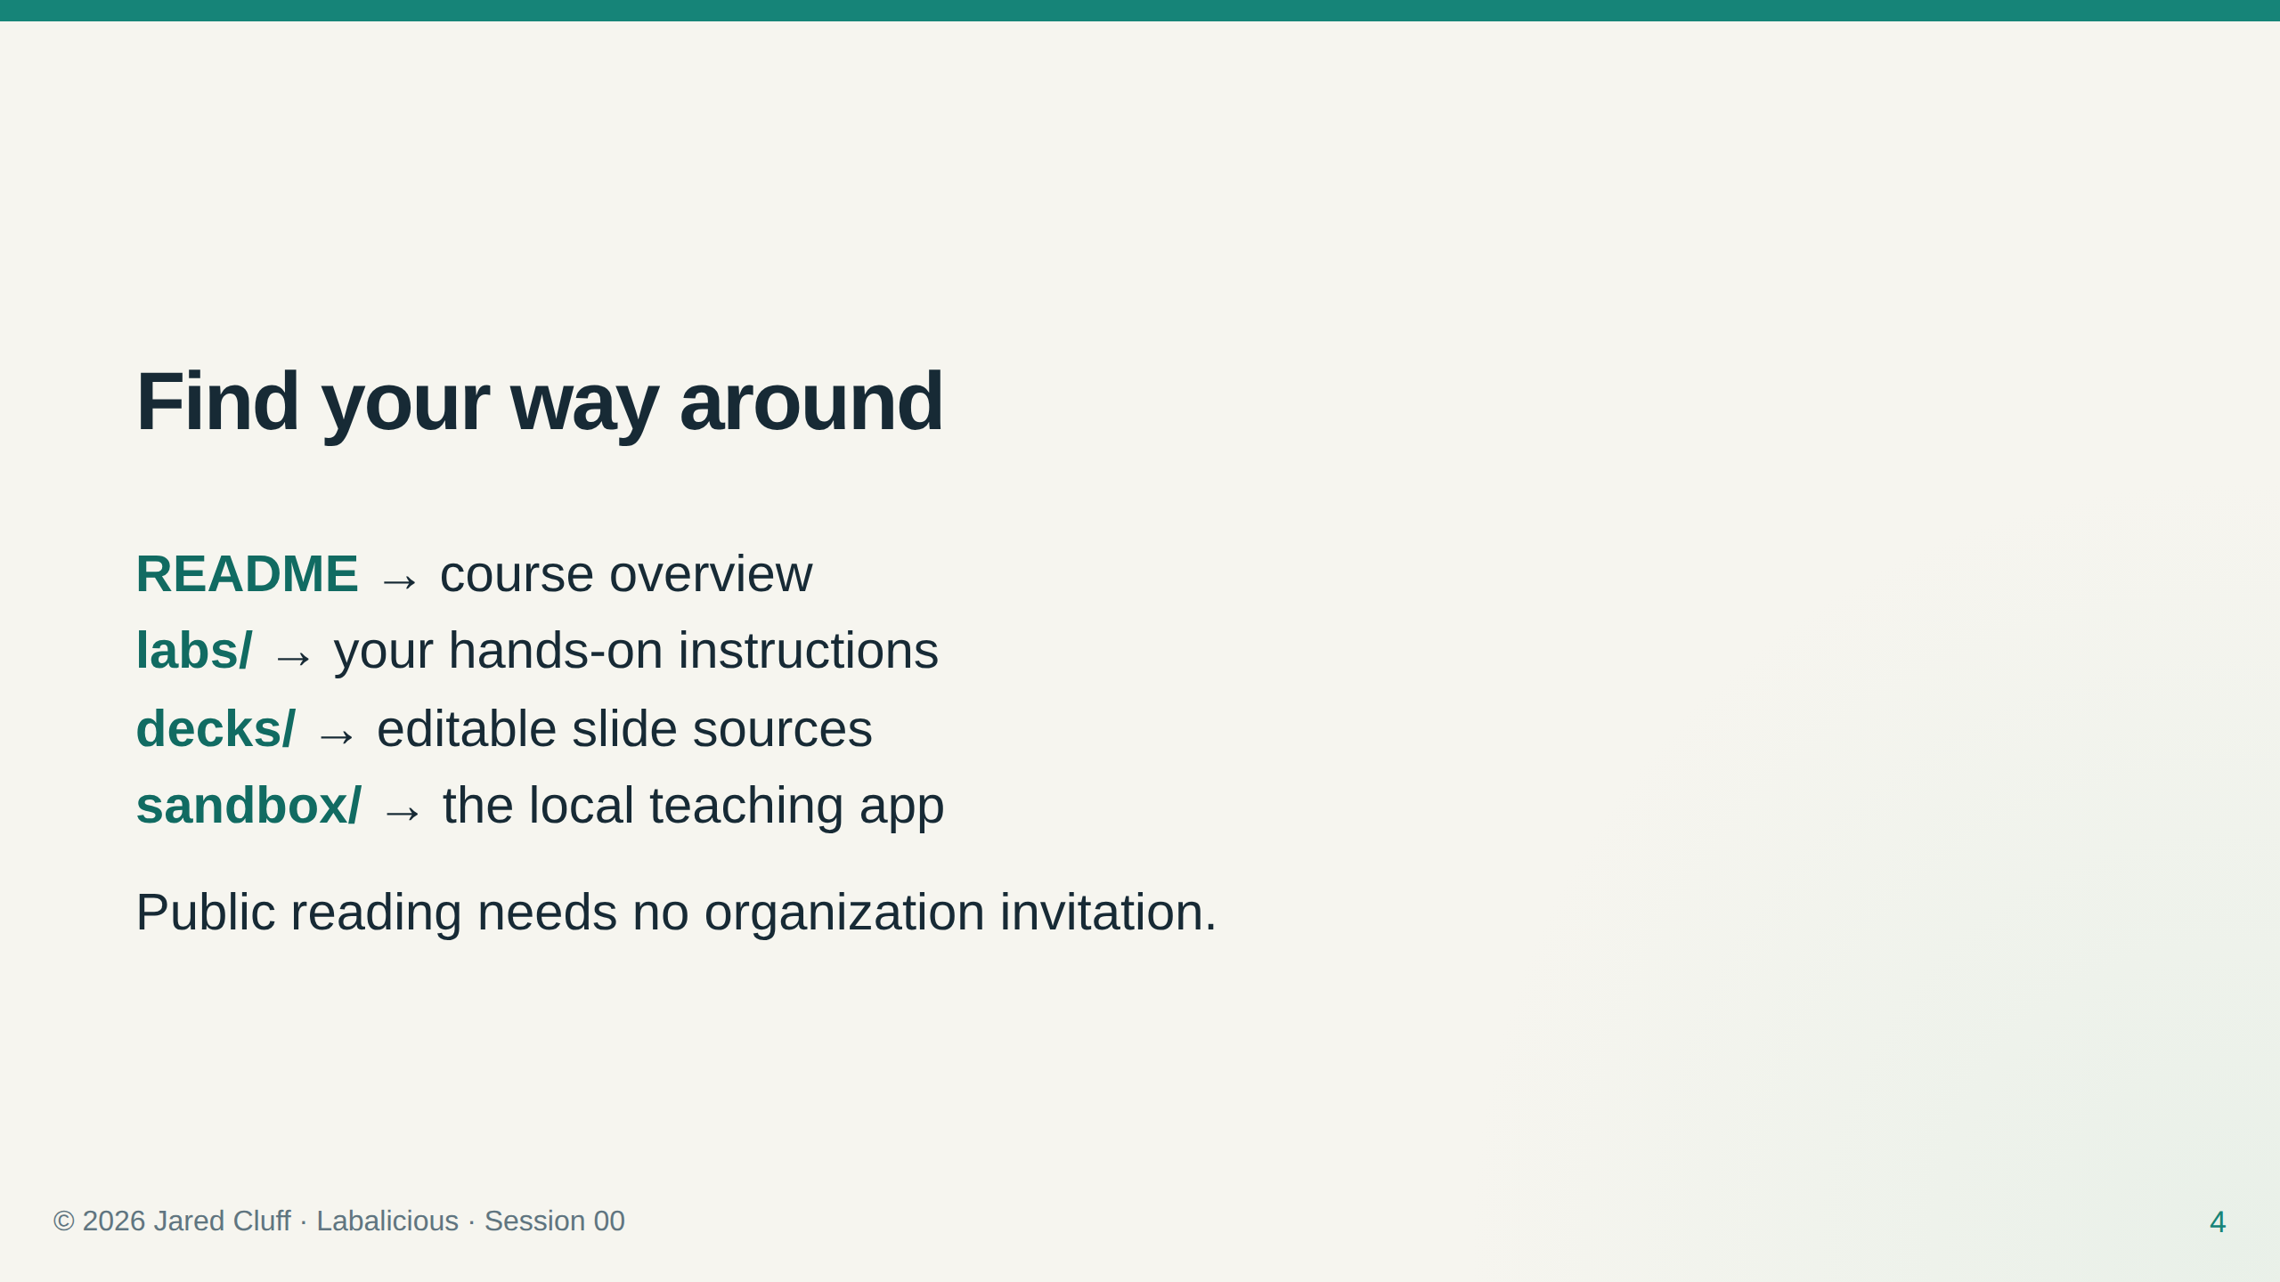

Slide 5
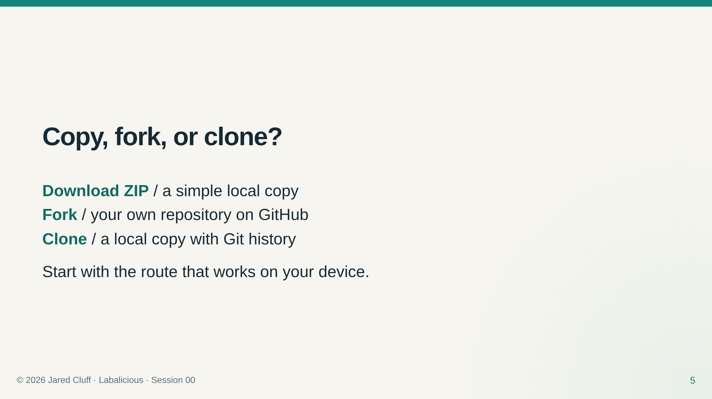

Slide 6
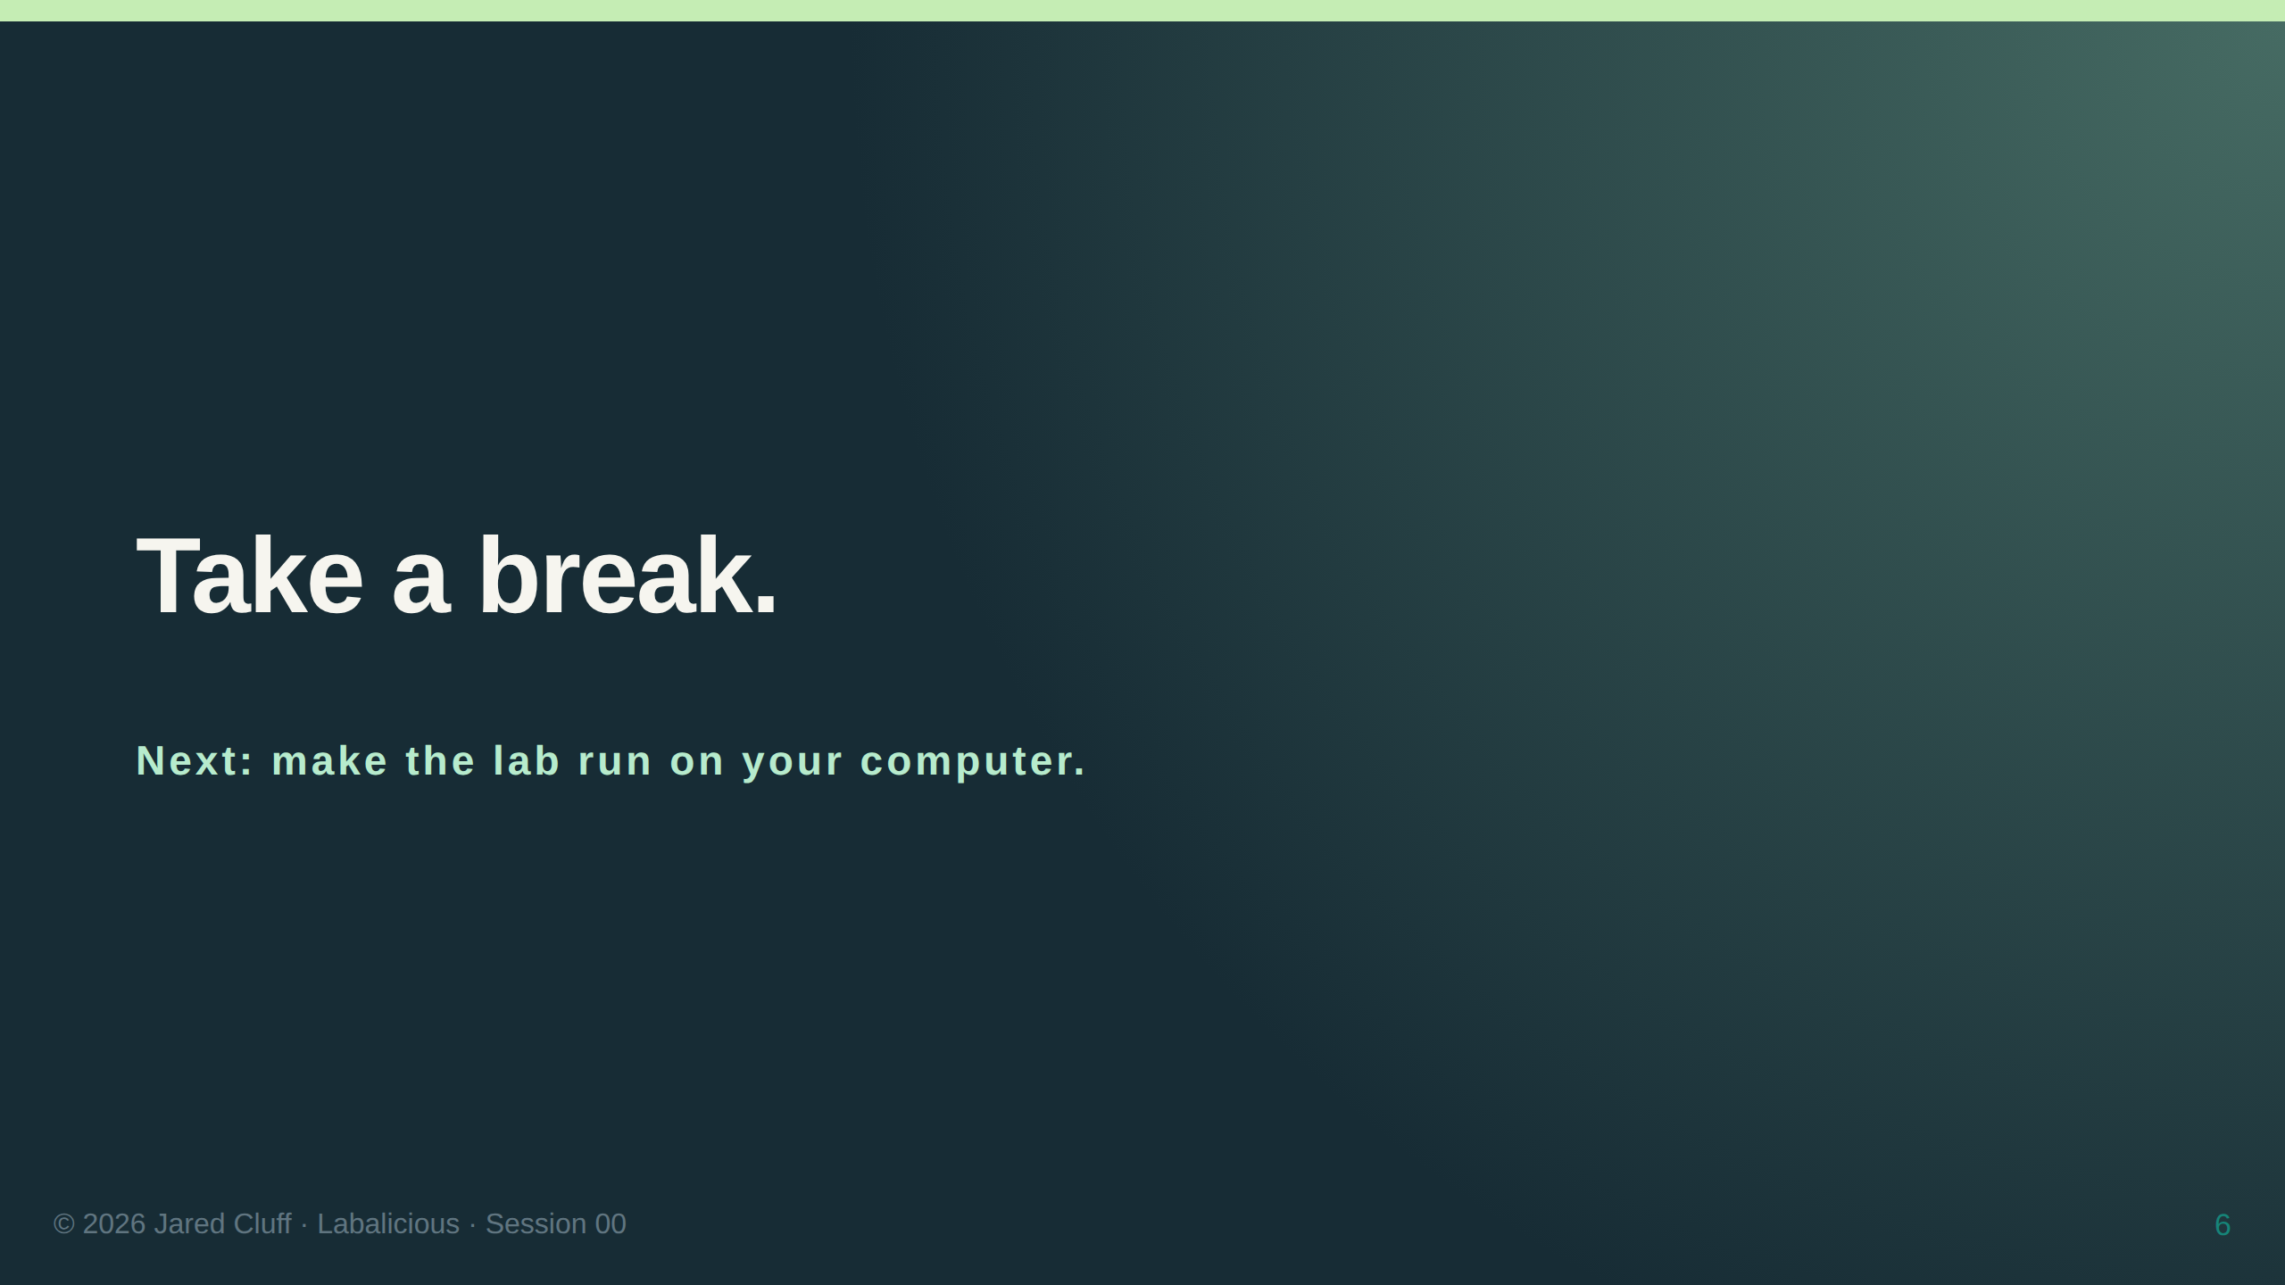

Slide 7
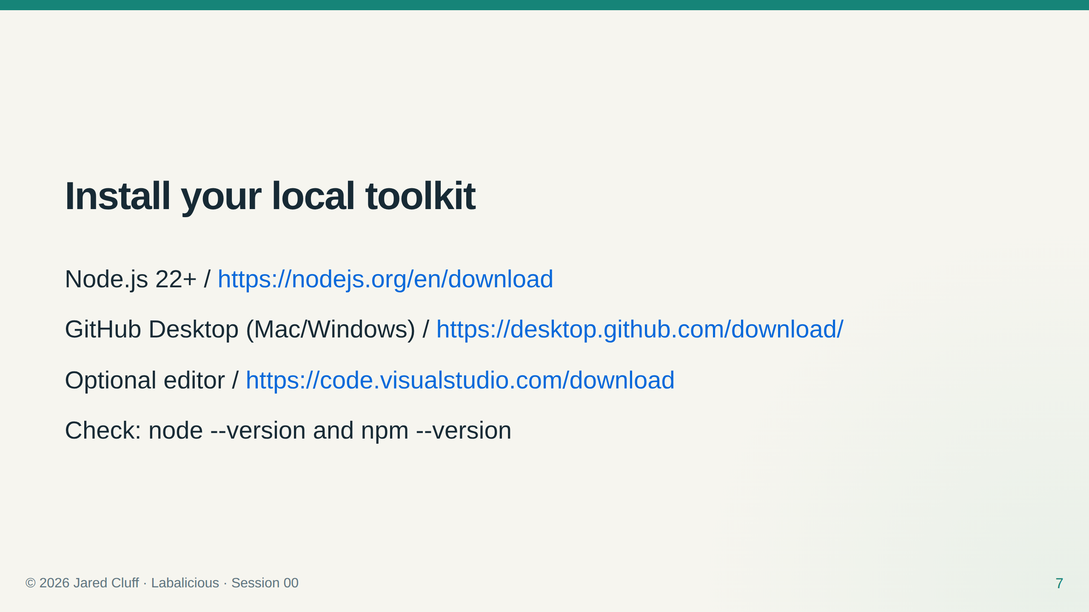
Notes:
Linux: use ZIP or Git CLI. On Windows use npm.cmd if PowerShell blocks npm.ps1. See PLATFORM_GUIDE.md.

Slide 8
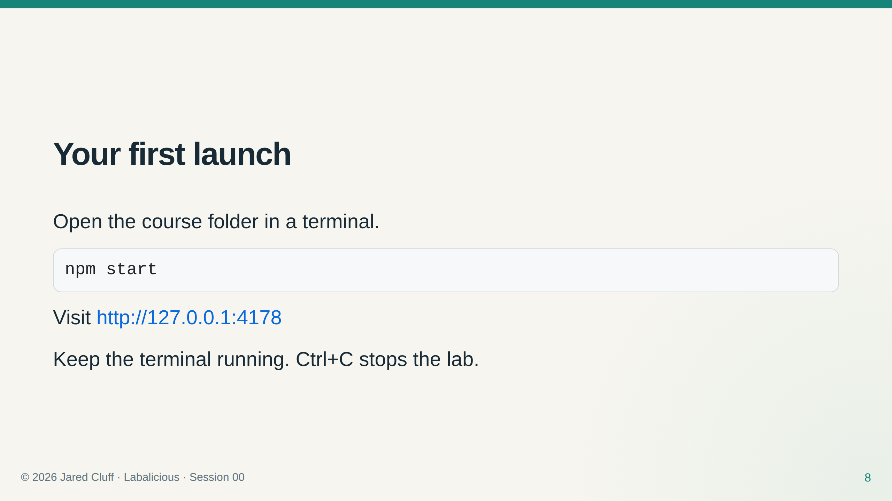

Slide 9
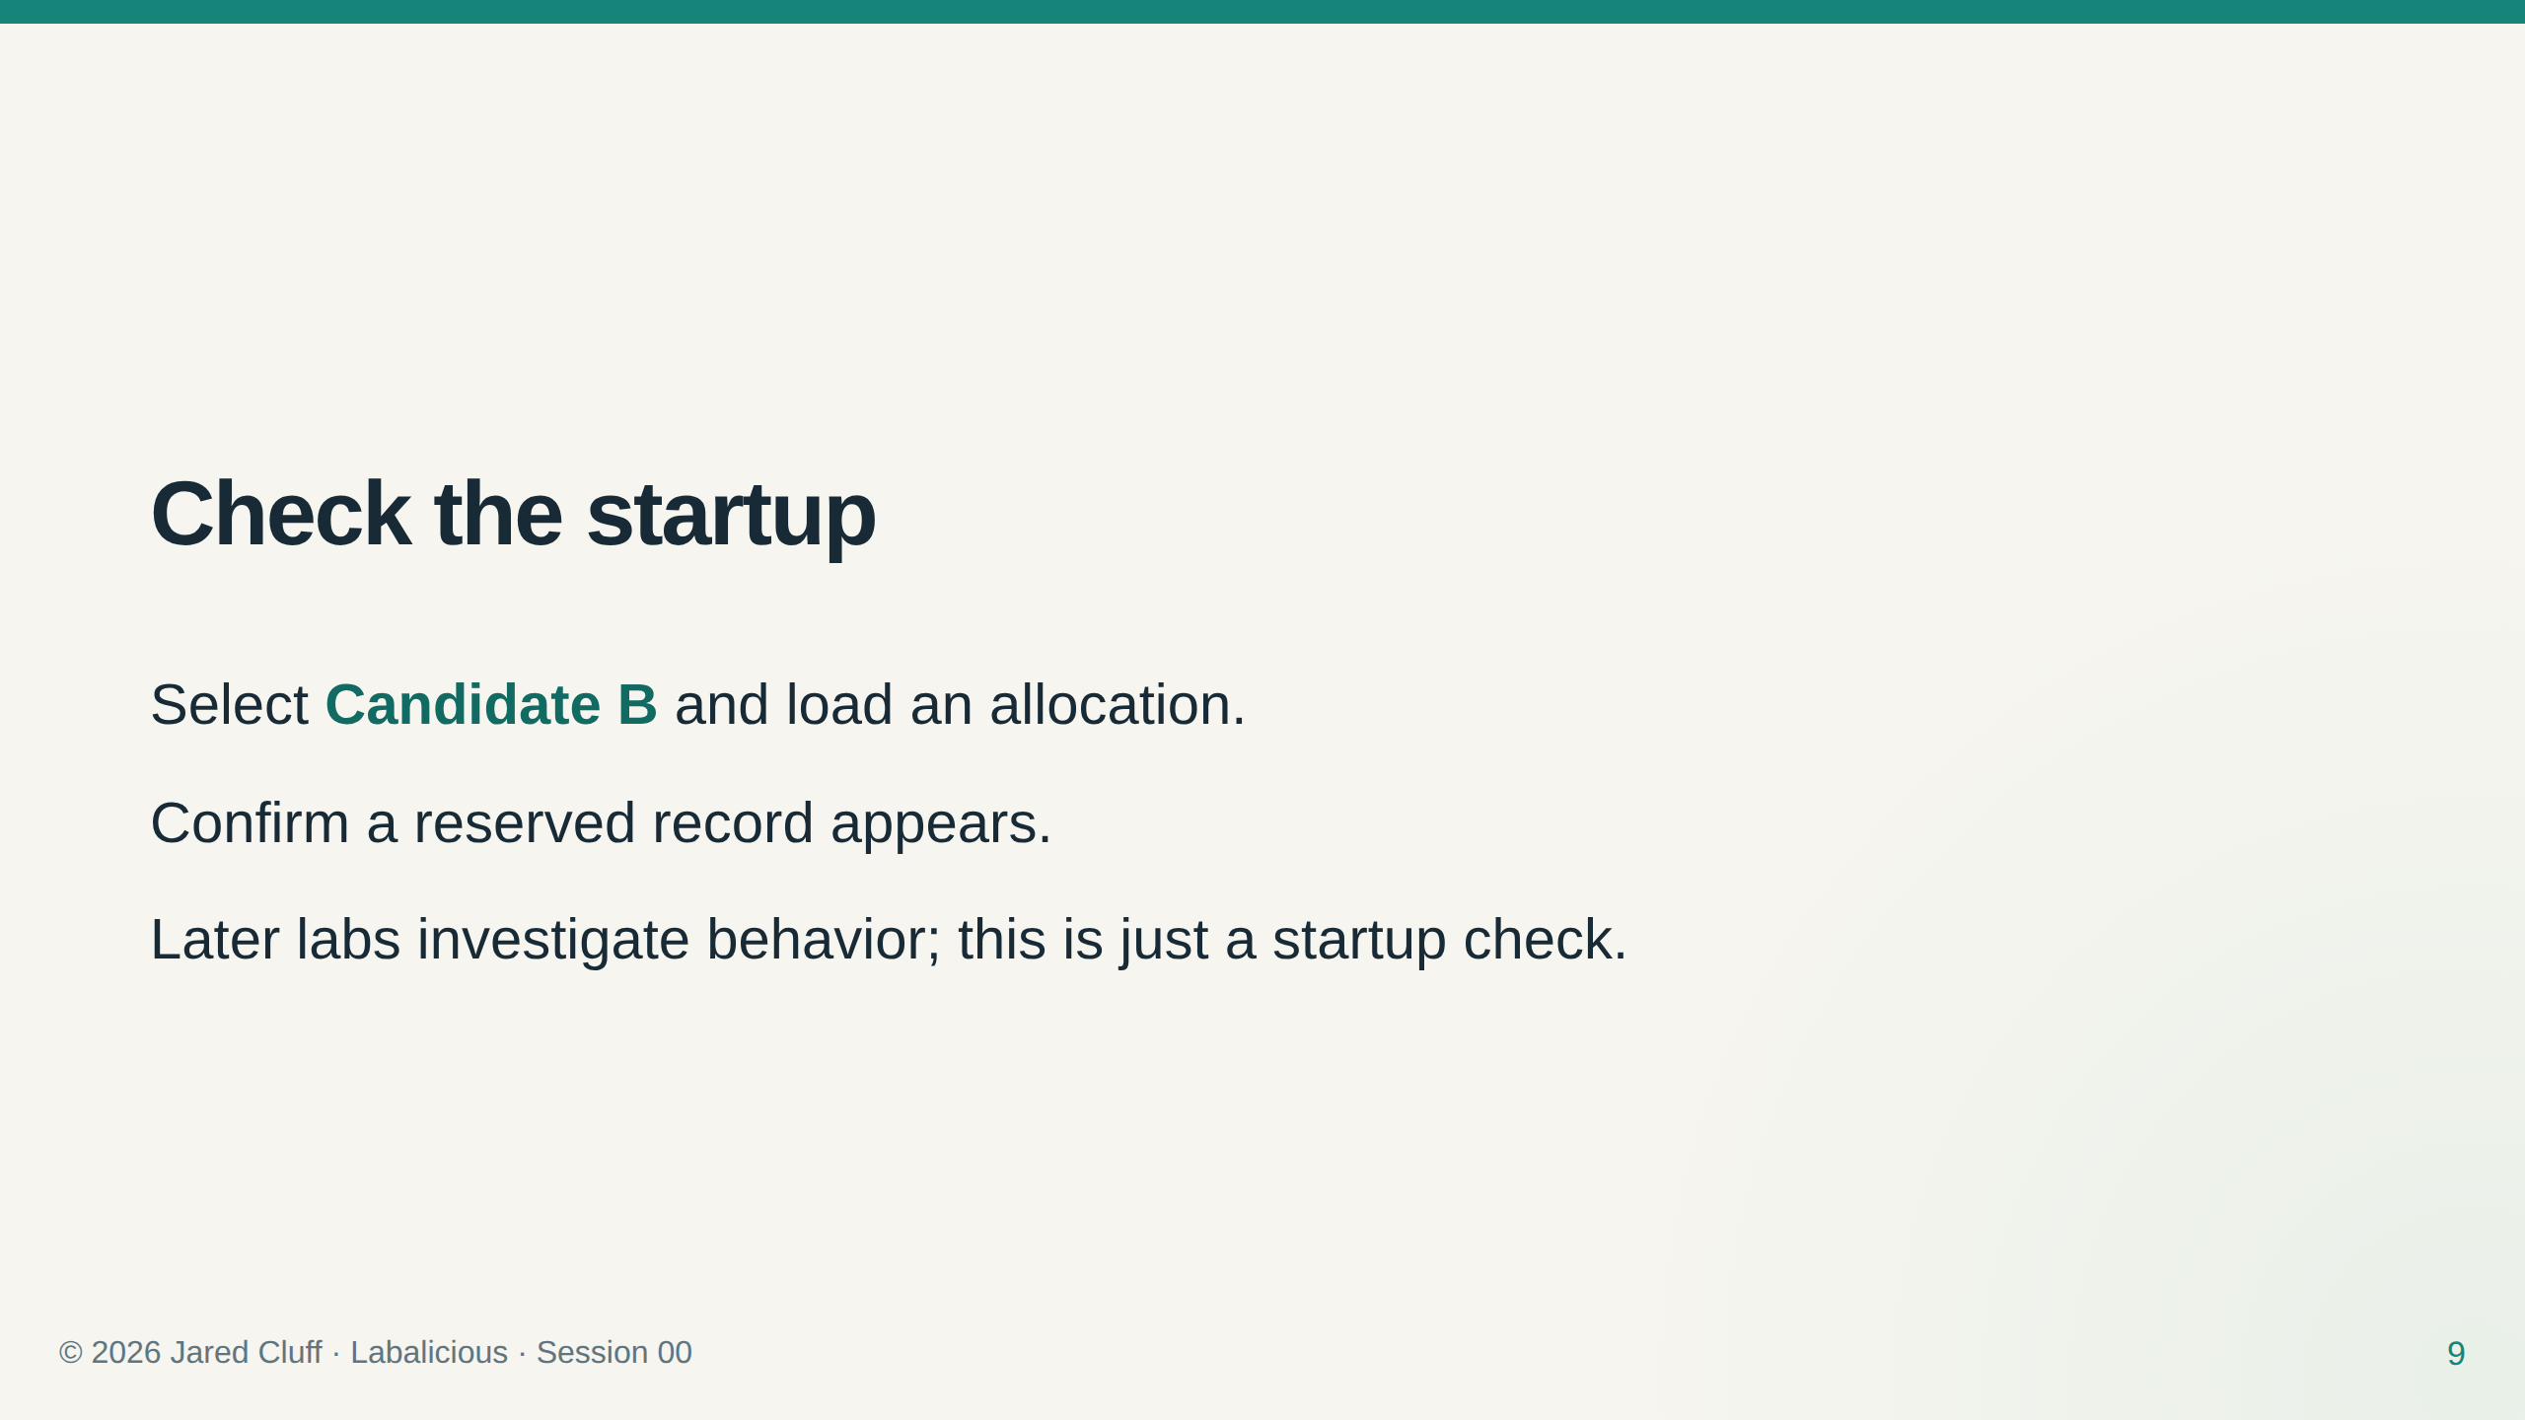

Slide 10
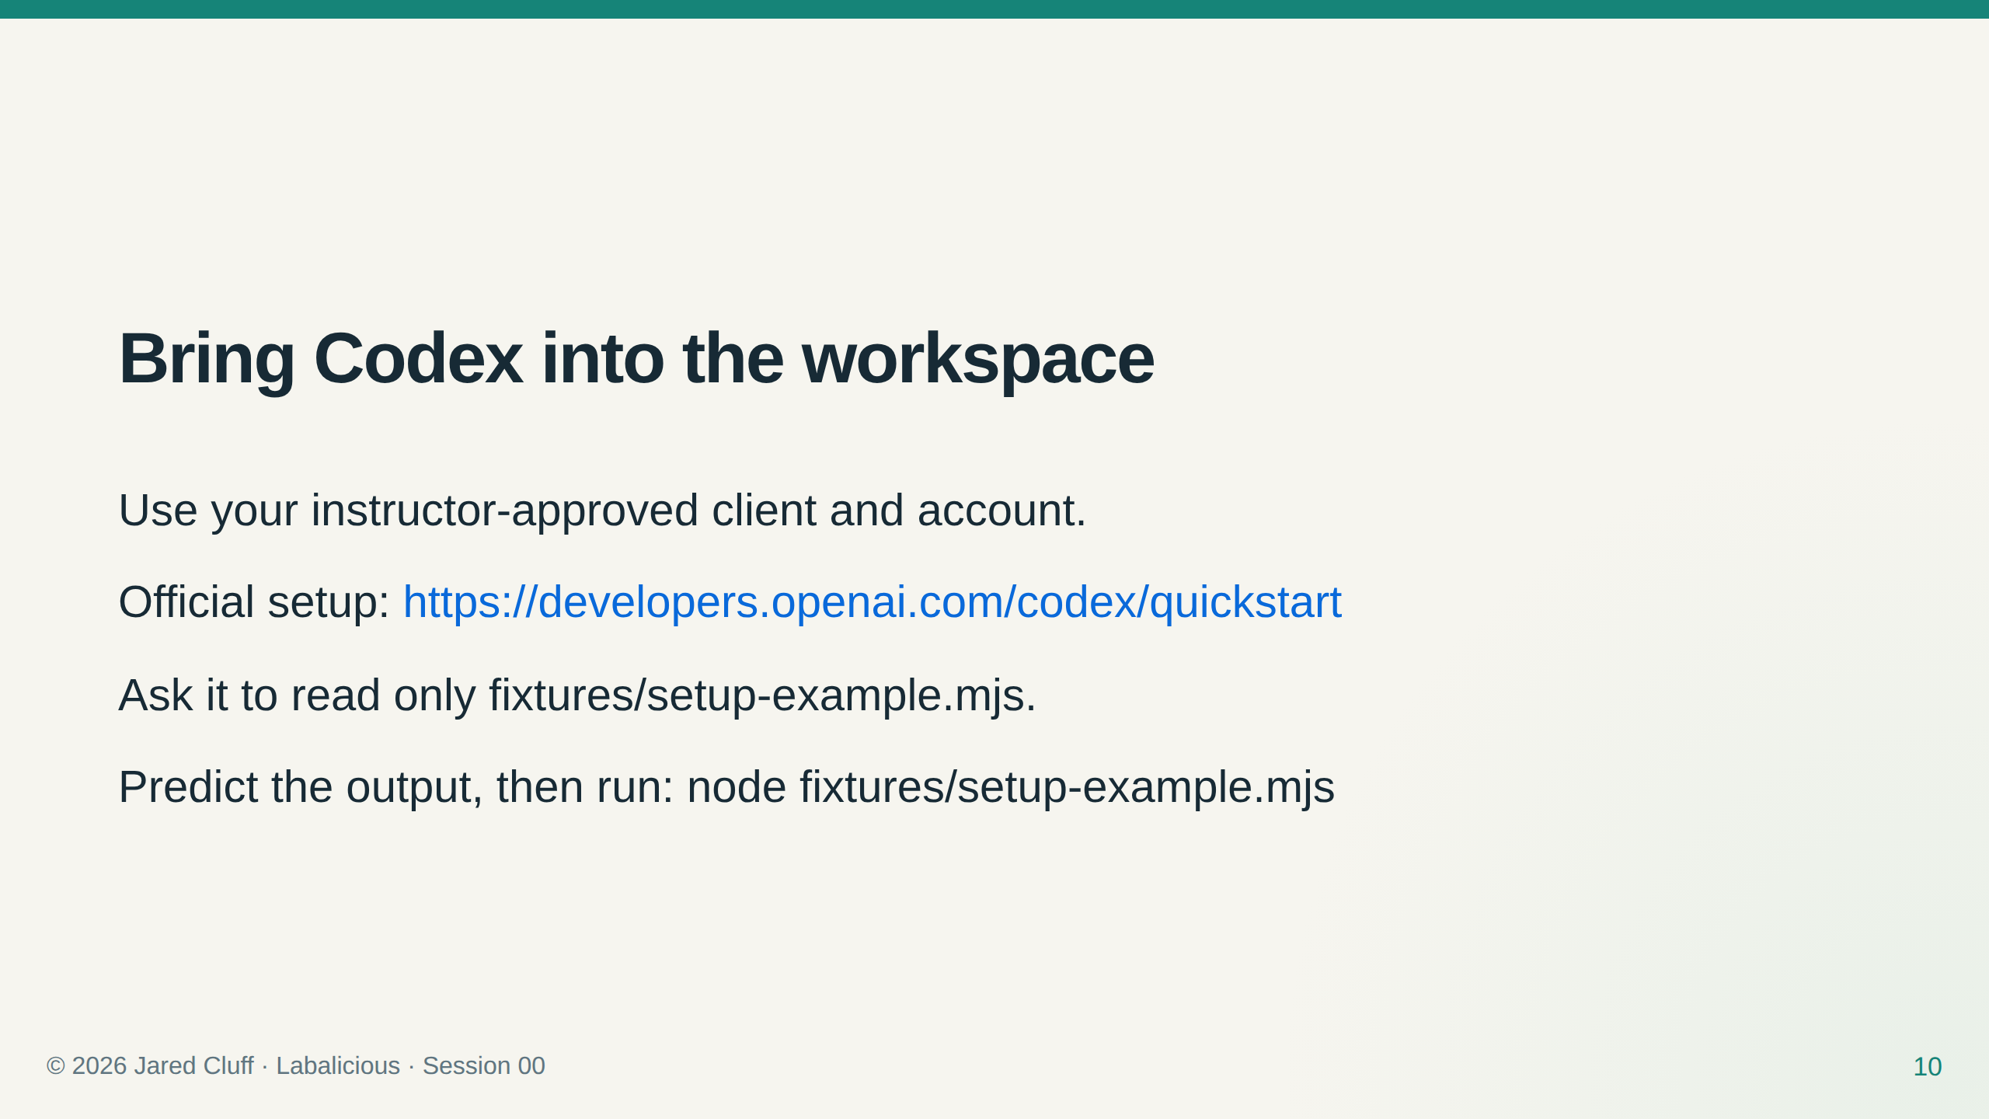
Notes:
Account availability varies. Do not promise a free plan or a specific model.

Slide 11
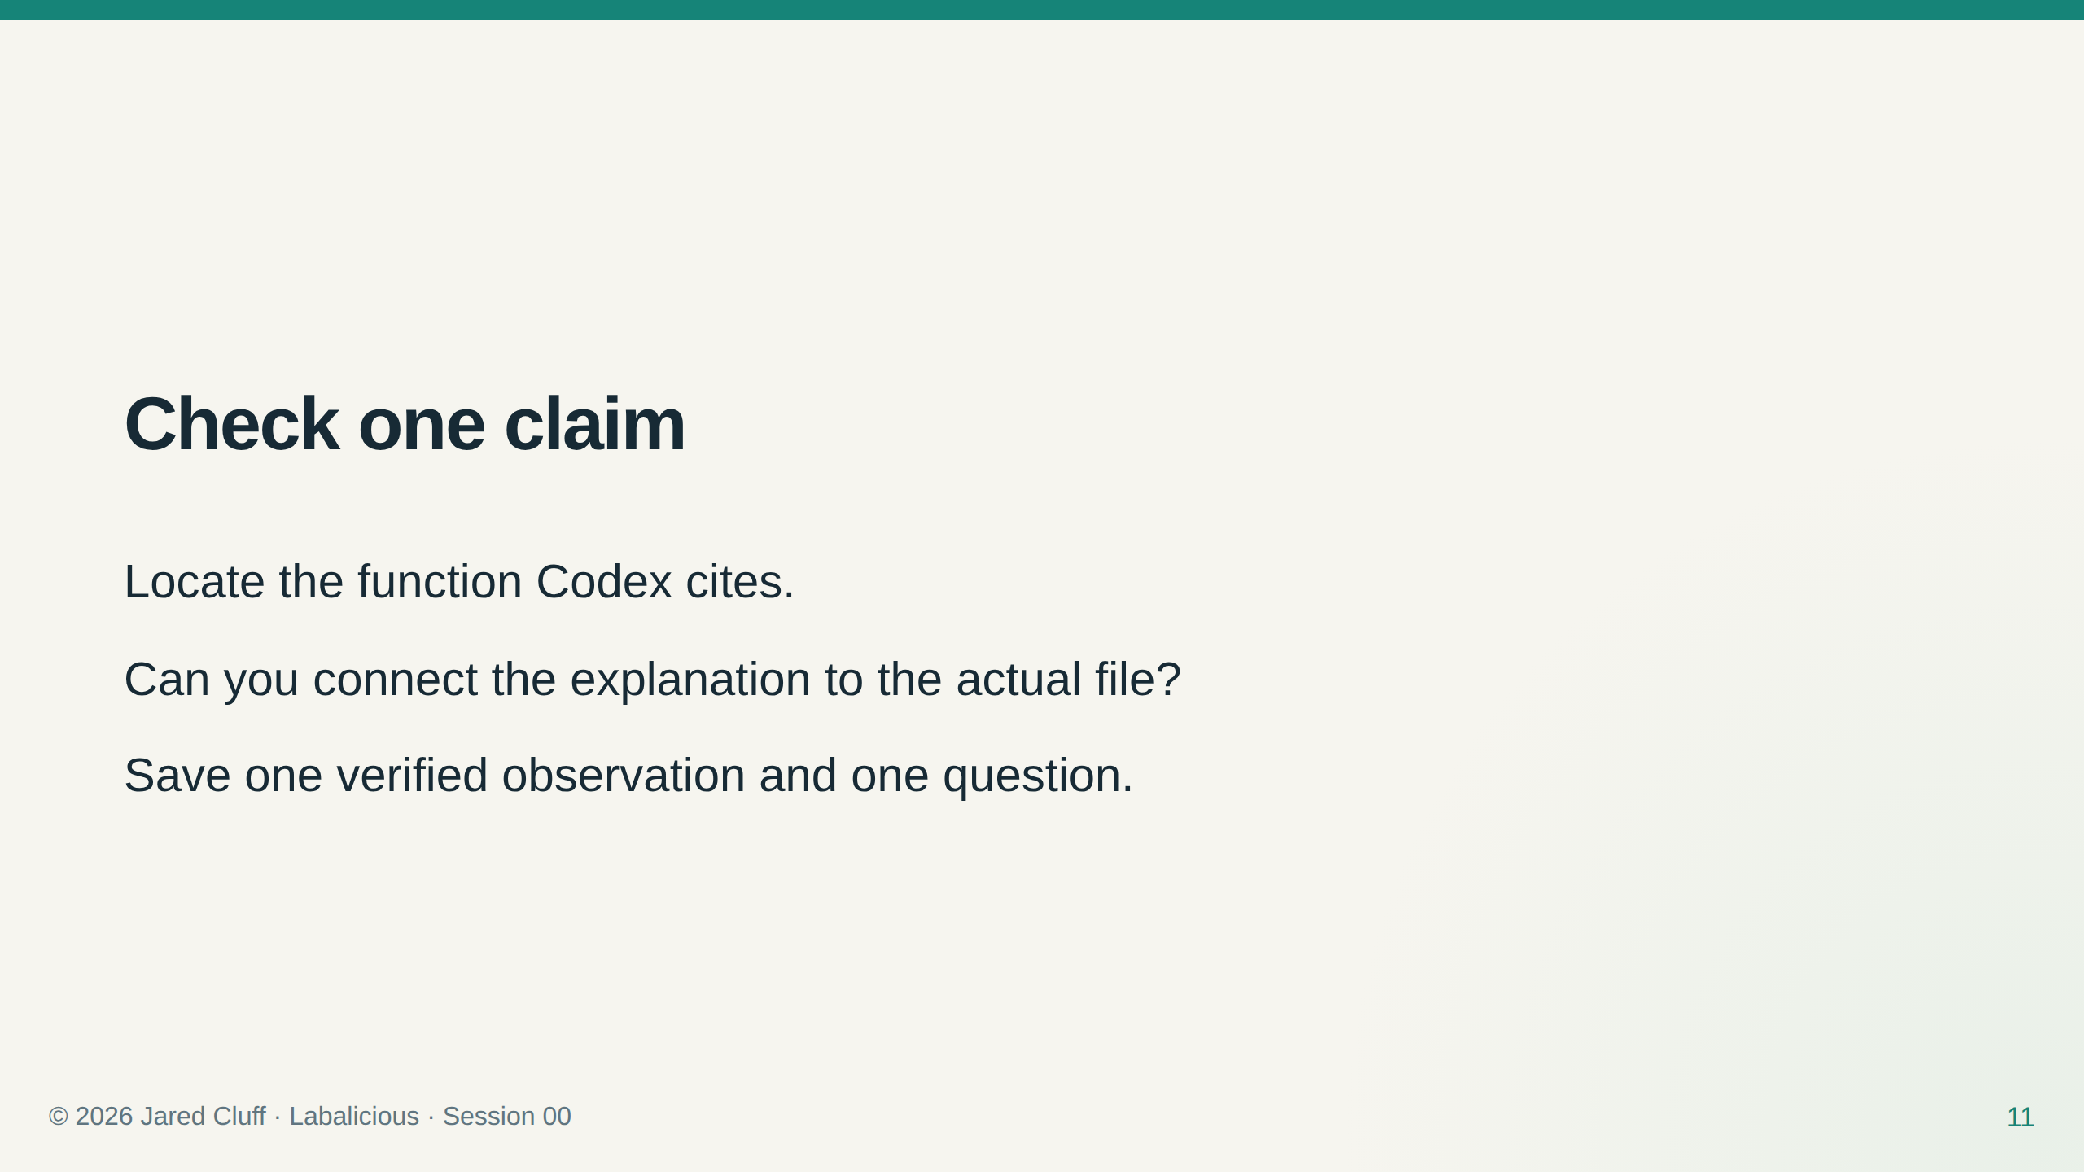

Slide 12
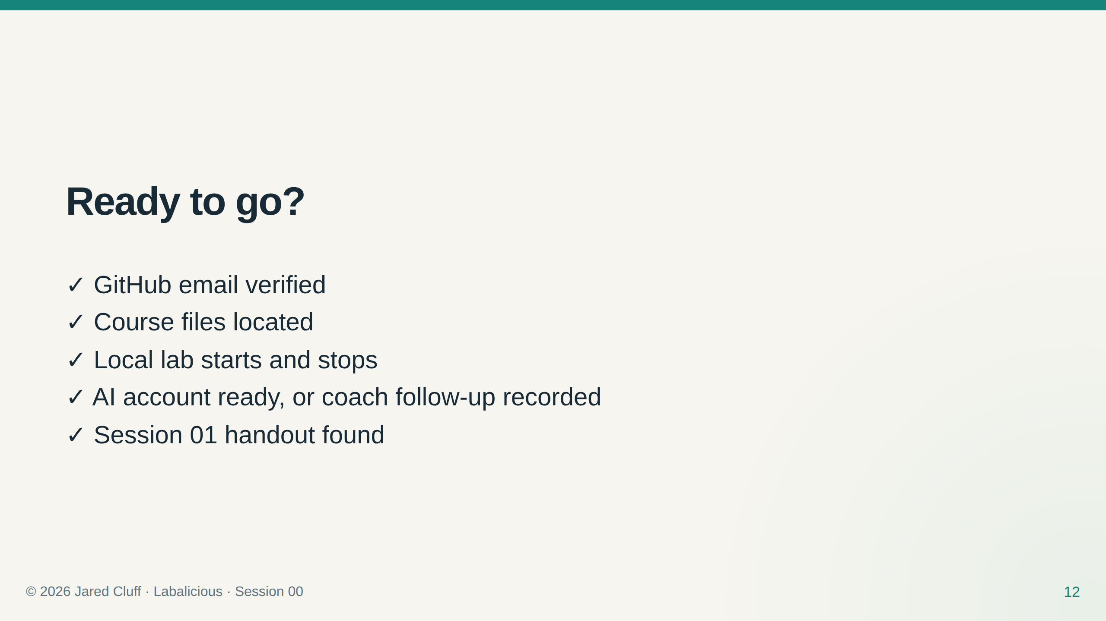
Notes:
Assess a demonstration, not installation speed.

